Slide 1
Welcome to Loyola
DESTINATION SUCCESS

Slide 2
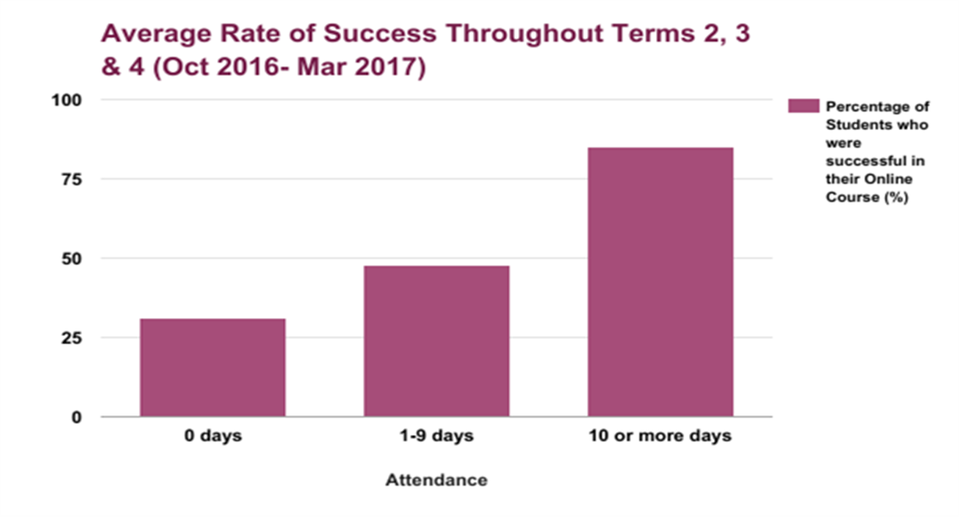
Action Research

Slide 3
Partnerships
Prince Edward Learning Center
Boys and Girls Club
Ontario Works
Hastings and Prince Edward Community
Chinese Cultural Communities
Corrections Canada

Slide 4
Summer Programs
Online Credit Courses
Literacy Camps
Grade 7-8 Literacy and Numeracy Camp
Sevens

Slide 5
Credit Recovery
Student Success Meetings
Credit Recovery Term

Slide 6
Program Summary
Literacy and Basic Skills
ESL and LINC
Credit Program – eLearning Hubs
Personal Support Worker

Slide 7
Questions? www.learningatloyola.ca

