Slide 1
Student Voice at Holy Cross
High school is what you make it
By Alexis Pascoal, Jacob Laframboise, Michael Faught, and Vince Stabile

Slide 2
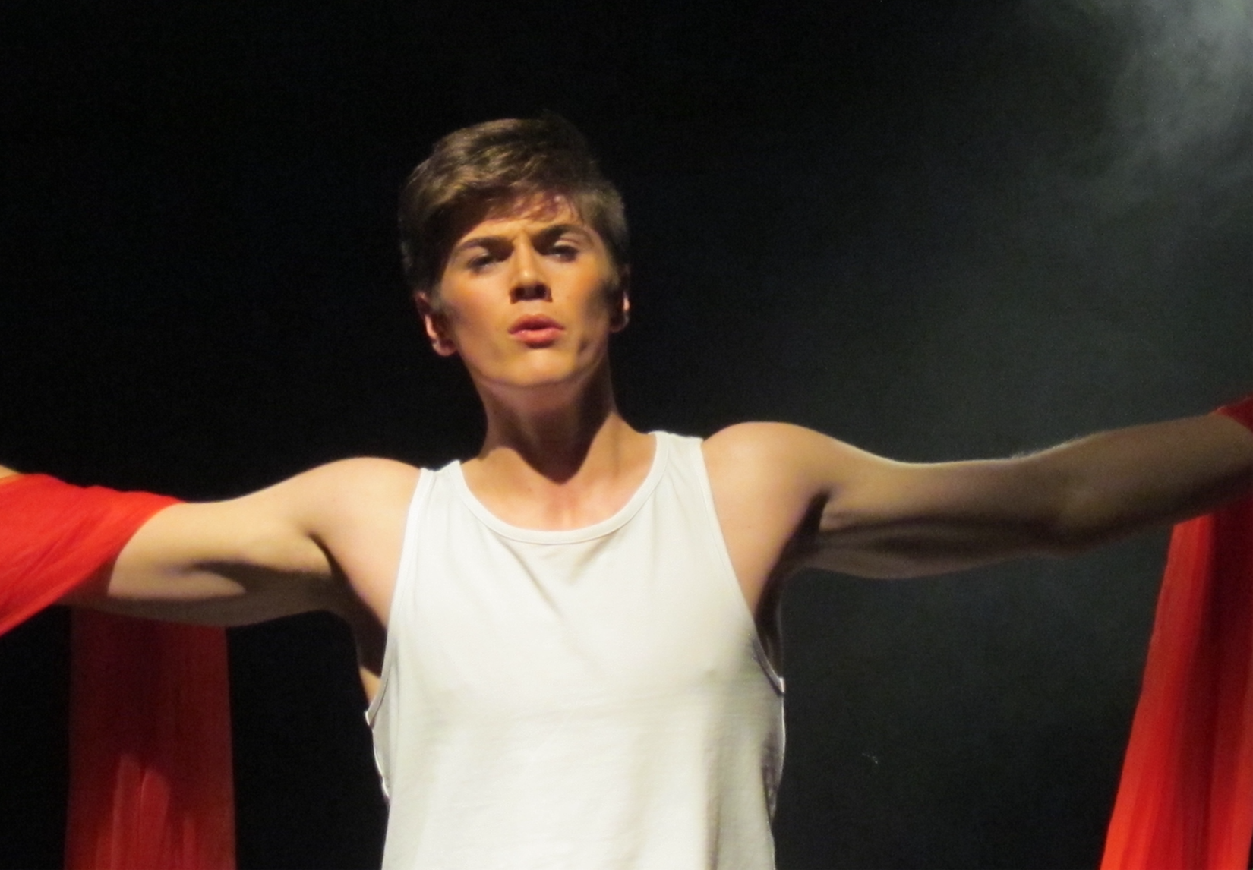
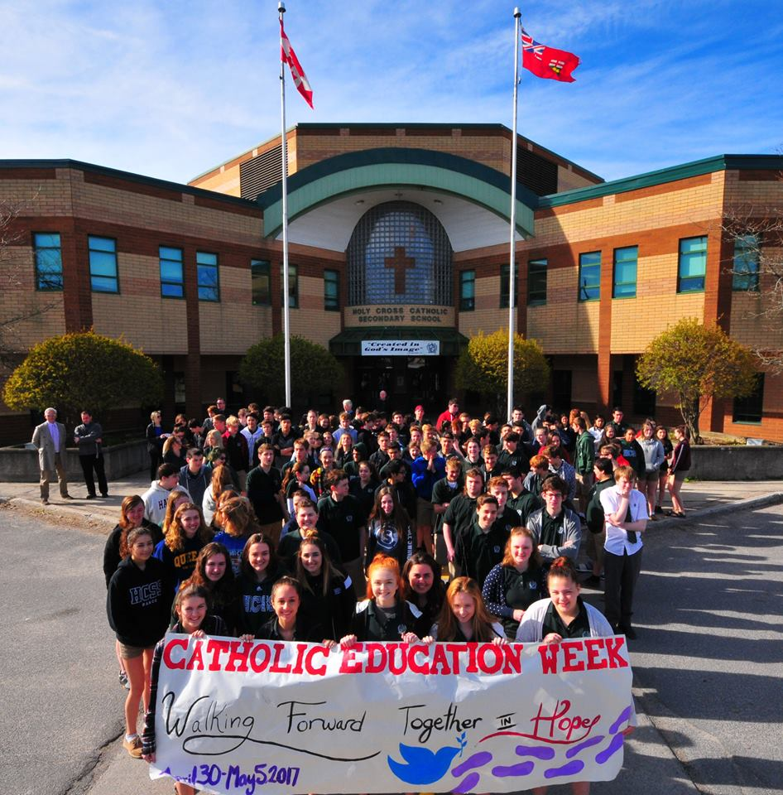
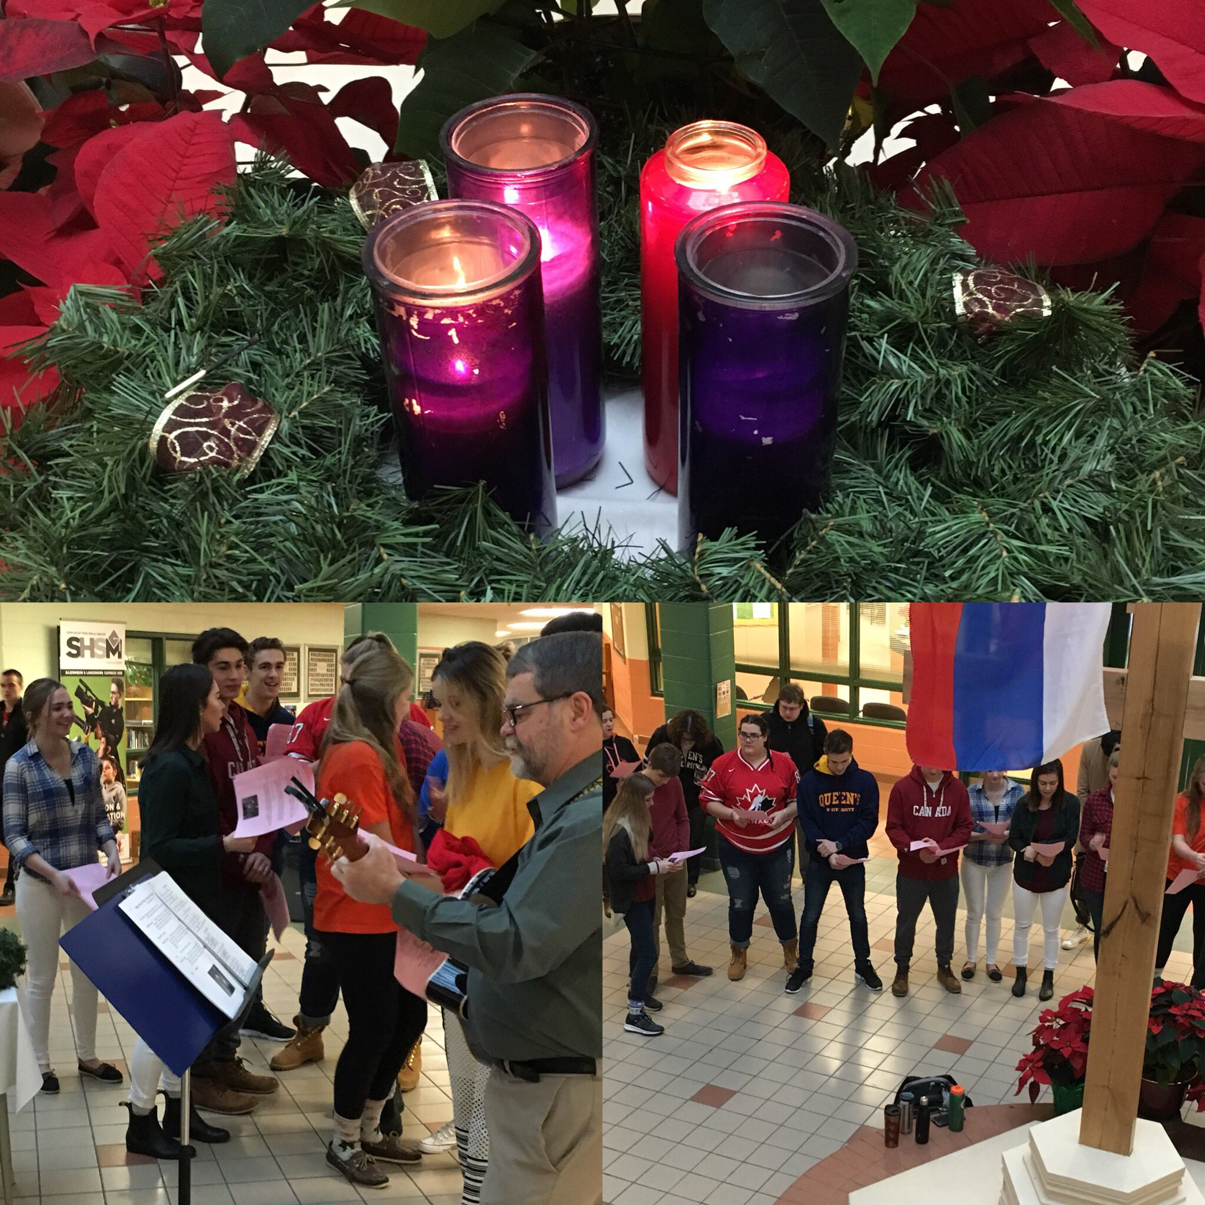
Our Faith

Slide 3
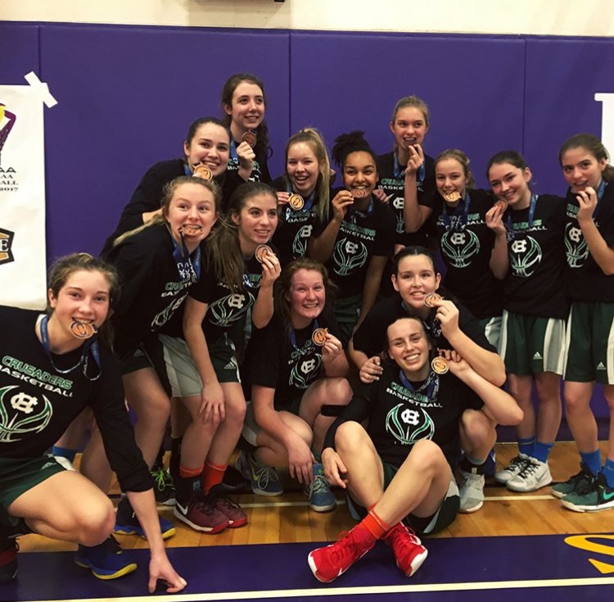
Holy Cross Athletics
Notes:
HC Athletics:
- Wide Variety of fall, winter and spring sports teams, including varsity basketball, volleyball, cross country, hockey, soccer, etc.
- This year Holy Cross had a very successful athletic department with a variety of teams having victorious seasons.
The Senior football team, Senior Girls Basketball Team, Boys Hockey team, and Girls Field Hockey team all captured the KASSAA title in the 2017-2018 seasons.
The Senior Boys Basketball team, Girls Field Hockey team, Boys and Girls Ice Hockey Teams, and Senior Girls Basketball team, all represented Holy Cross at the OFSAA Championship.
The Senior Girls basketball team won an OFSAA bronze medal, and the Boys Hockey team won an OFSAA silver medal.
Ashton McCulloch, Kiley Rodrigues and Emily Calder took their golfing skills to OFSAA.
Many Cross Country runners were successful in KASSAA and further advanced to OFSAA.
Tyson Fletcher won an OFSAA silver medal and Brennan LaPlante Brady an OFSAA bronze in wrestling.
4 Holy Cross star football players, Tyson Fletcher, Jacob Jefferies, Matt McDonald and Laurenio Sousa all committed to Queens University Mens Football team for the 2018-2019 season.
Holy Cross Boys’ volleyball teams, as well as the Girls Basketball teams participated in the annual PH Classic to raise money and awareness for breast cancer research.
Additionally the Boys Basketball teams had an honourable game with all proceeds going to the KGH pediatrics floor.

Slide 4
Notes:
On April 12, the Holy Cross staff and students participated in the nationwide jersey day in honour of the Humboldt Broncos victims. All the proceeds and donations were sent to the families and the Bronco community.
Additionally, Holy Cross staff and students took part in the annual inside ride which is an indoor cycling challenge and fundraising event that is dedicated to raising money in support of children with cancer and their families.
The annual dodgebowl was held at Holy Cross. Participating schools included Holy Cross, Regi, KCVI and Frontenac. Over $600 from this event was donated to the MS Society.
HC athletics are a great way to get the student body and staff members involved and display their crusader pride. The Holy Cross spirit squad is composed of council members, as well as other students that want show their support and cheer on the HC sports teams.

Slide 5
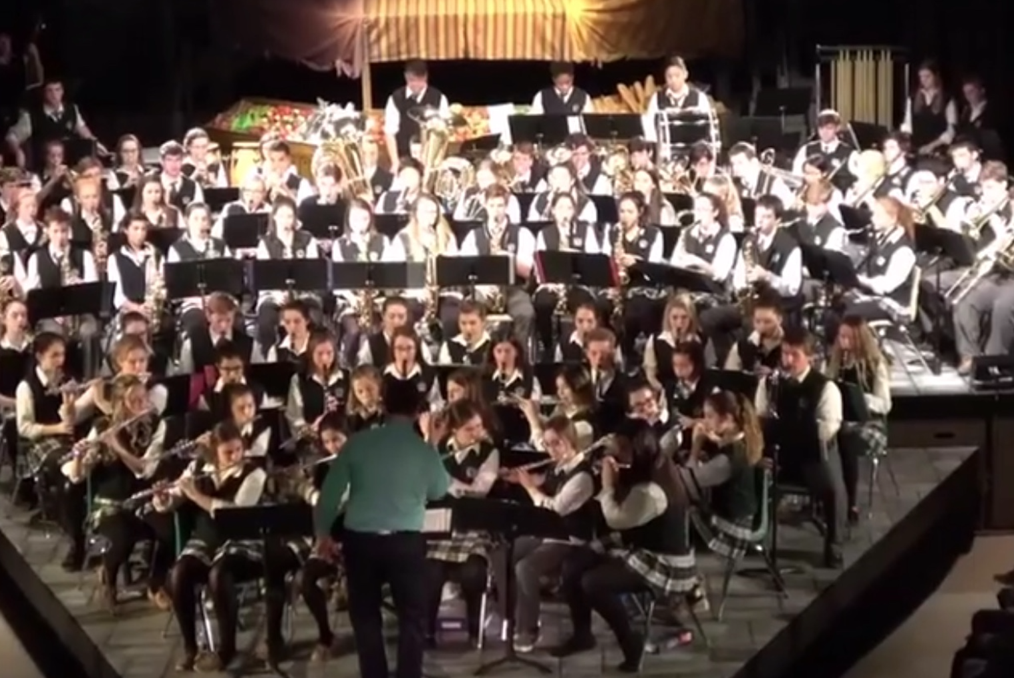
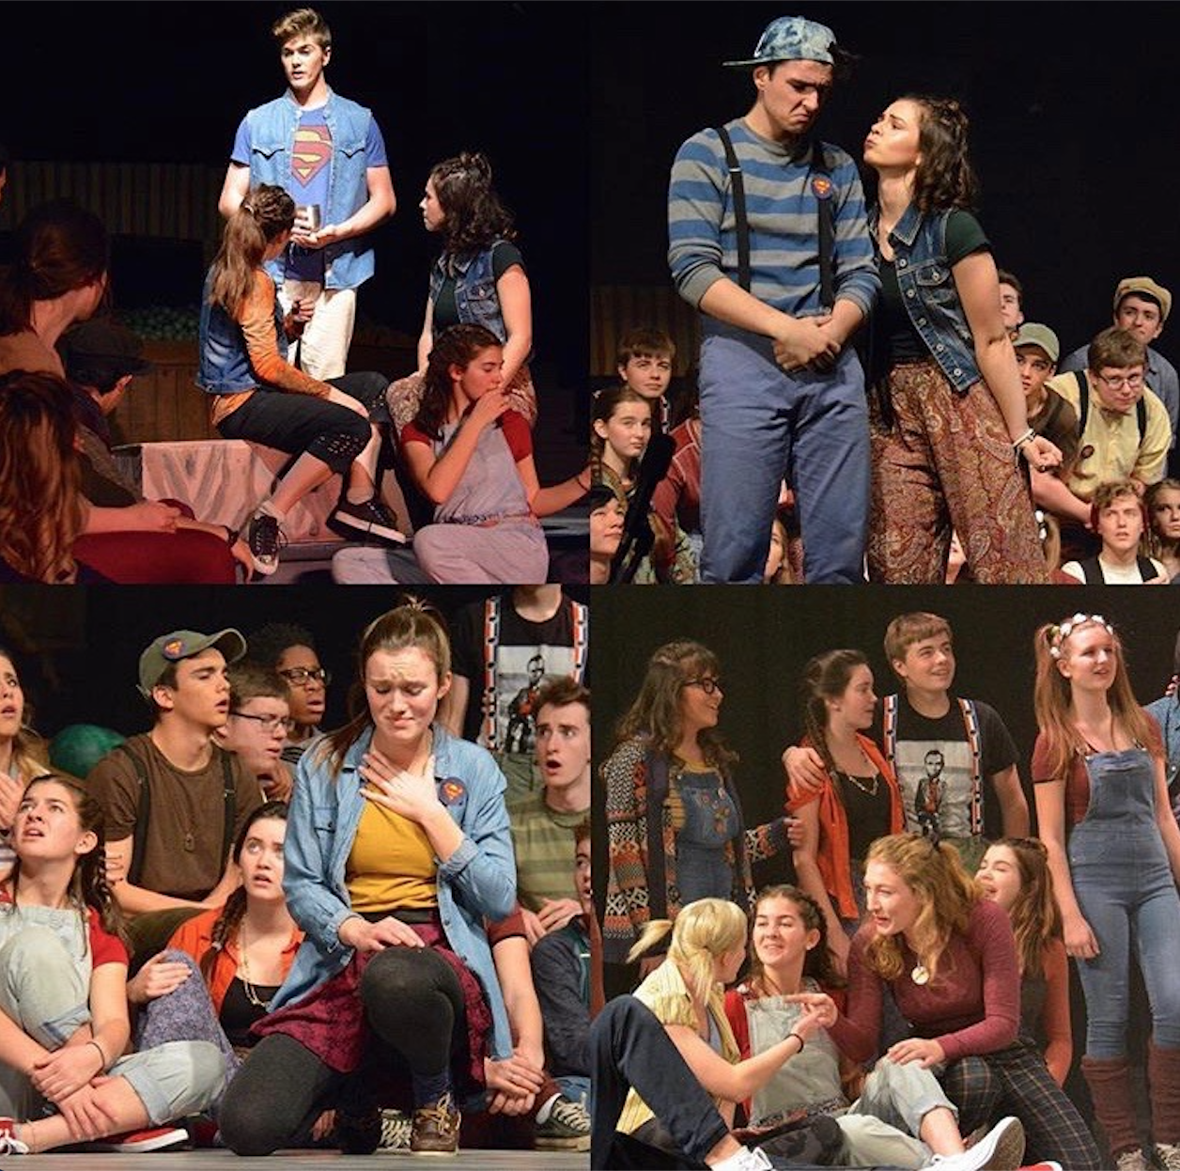
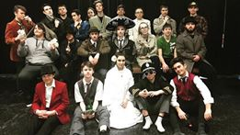
Arts

Slide 6
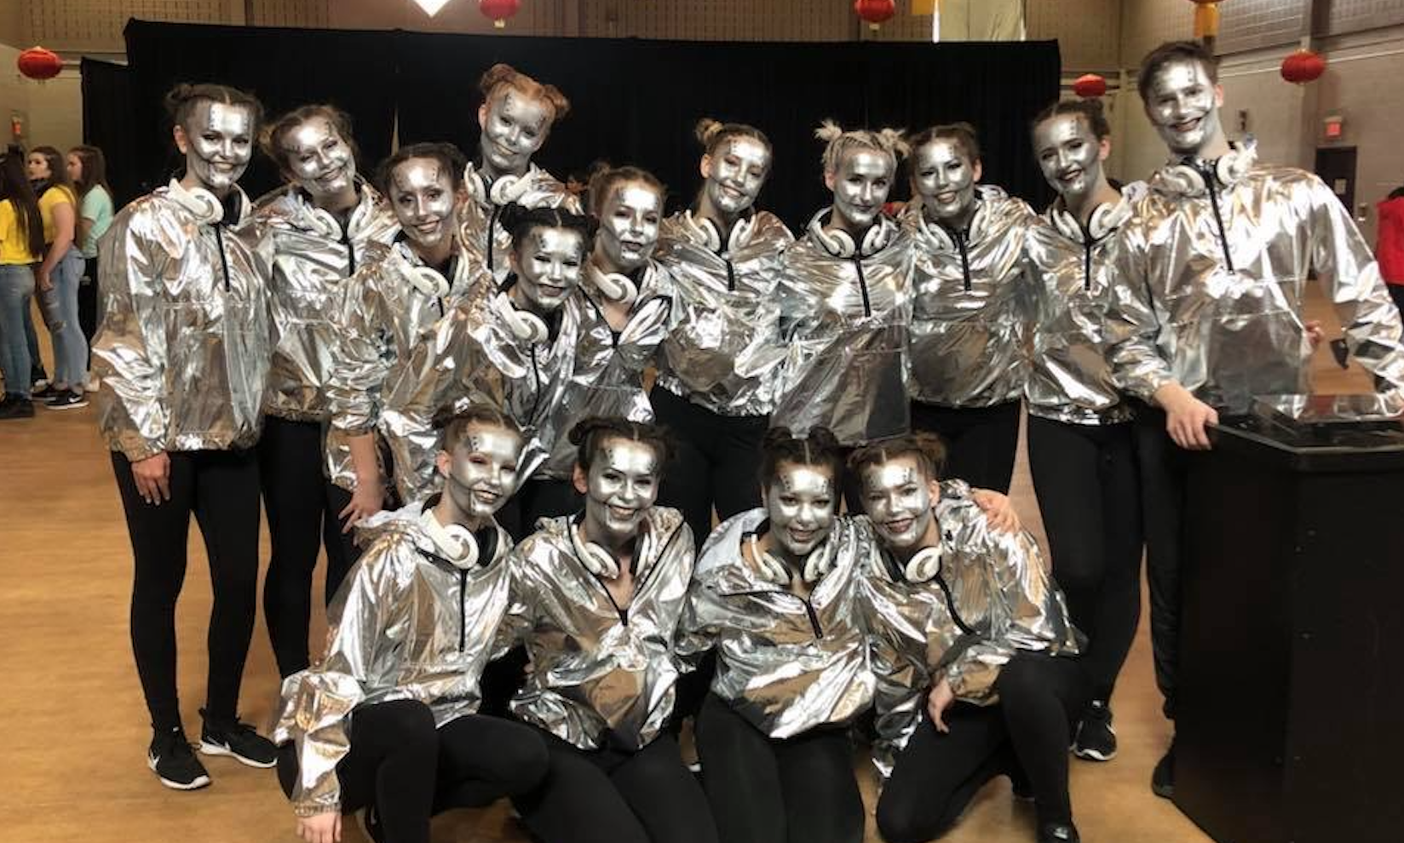
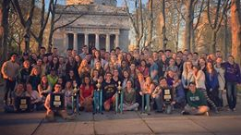
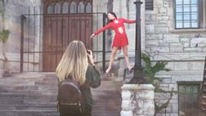
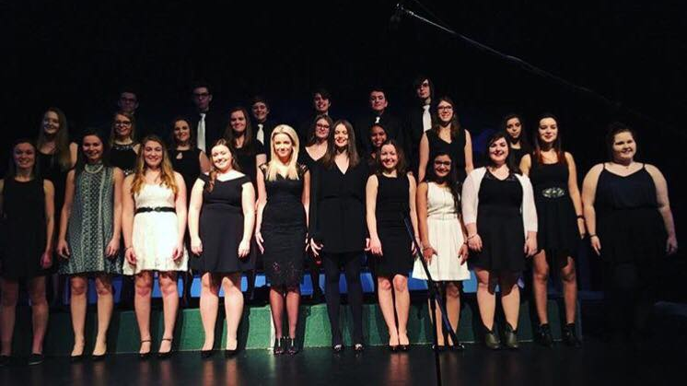

Slide 7
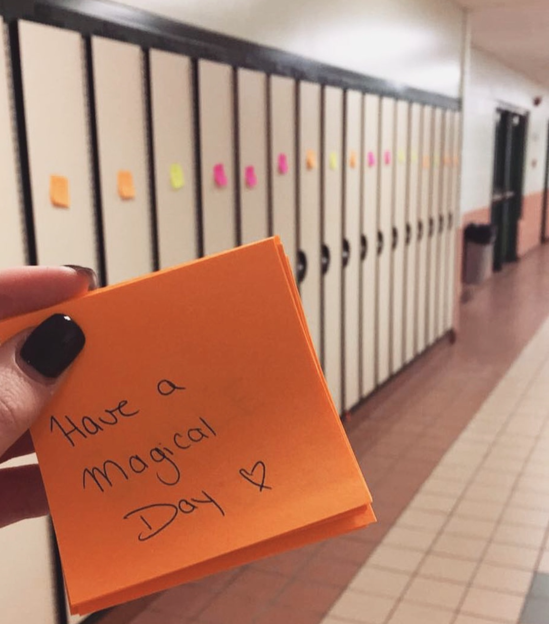
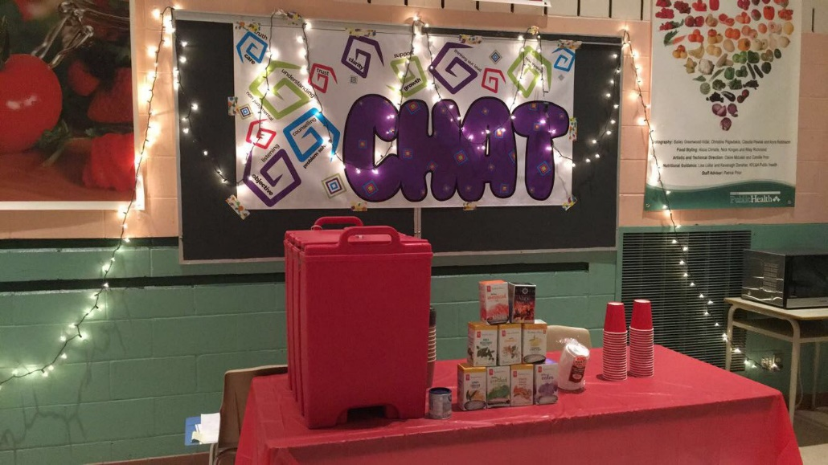
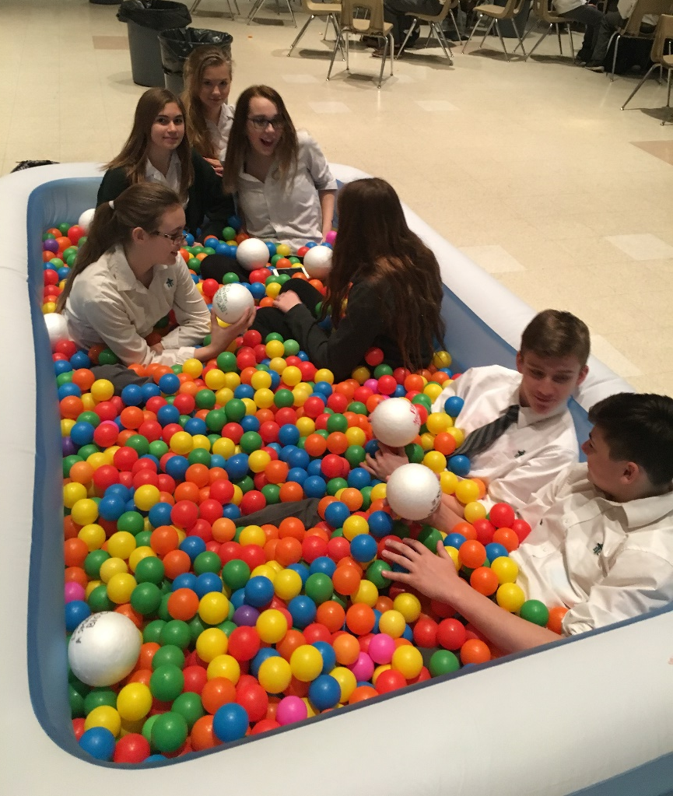
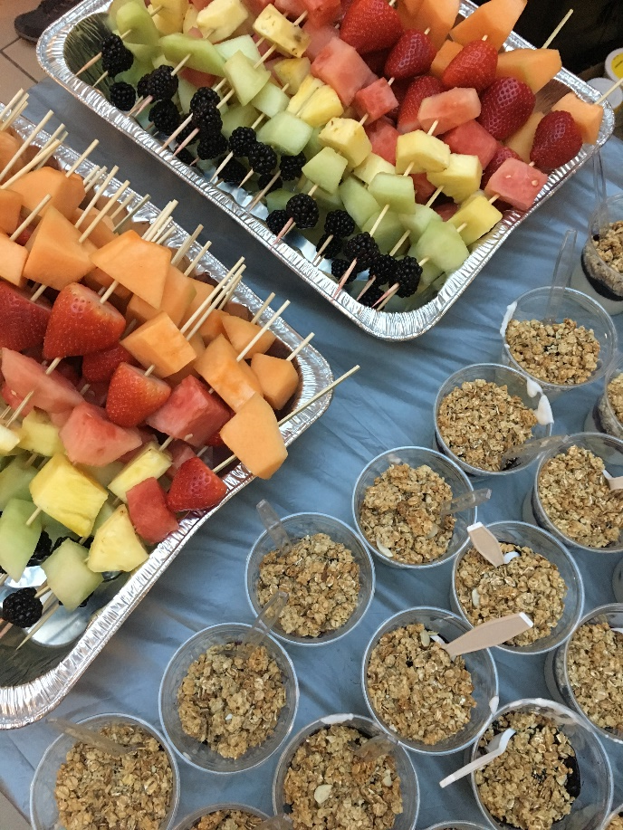
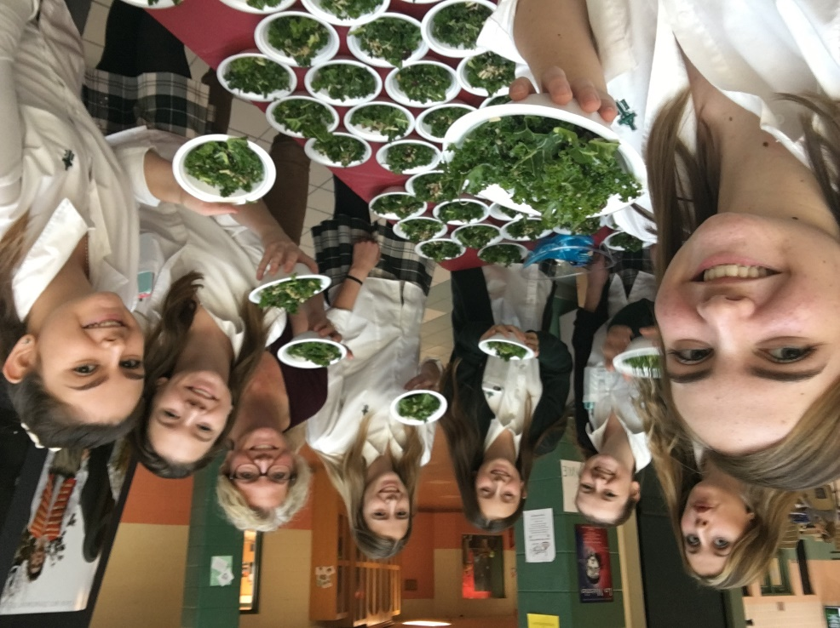
Wellness Team
Notes:
-Monthly event called Wellness Wednesday where we prepare and distribute free, nutritious snacks to the staff and students at Holy Cross.
-Instrumental in purchasing a salad bar for the school’s cafeteria. This provides students with a healthier option for lunch.
-The Wellness Team also organizes a ‘Wellness Week’ in February that involves activities that fit our themes of ‘Fuel, Chill, Chat, and Play’.

Slide 8


Notes:
-This year, we decided to focus our ‘Wellness Wednesday’ event on mental health.
-The Wellness Team has partnered with the Queen’s Clinical Psychology Outreach Program, and a Kingston psychologist to bring mental health workshops to students at Holy Cross.
-Once a month, Queen’s psychology students come to our school and deliver workshops to students that aim to help them with their mental health by giving them strategies and resources to use.

Slide 9
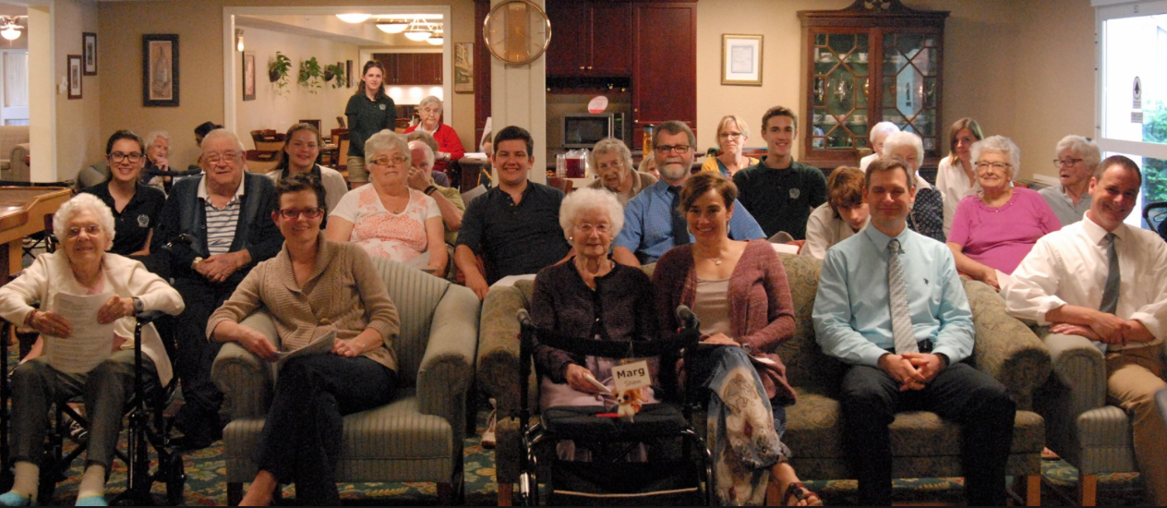
CRUSADERS IN COMMUNITY
SERVICE (CICS)
Notes:
-Our annual Advent collection where we raised money for the Jamaica mission trip and the KGH teddy bear campaign.
-Our annual Lent collection where we fundraised for Development and Peace.
-Thinkfast: students and staff fast for 24 hours as well as fundraise to stand in solidarity with people around the world who go without food.
-Monthly visits to Rosewood retirement home to sing with the elderly.

Slide 10
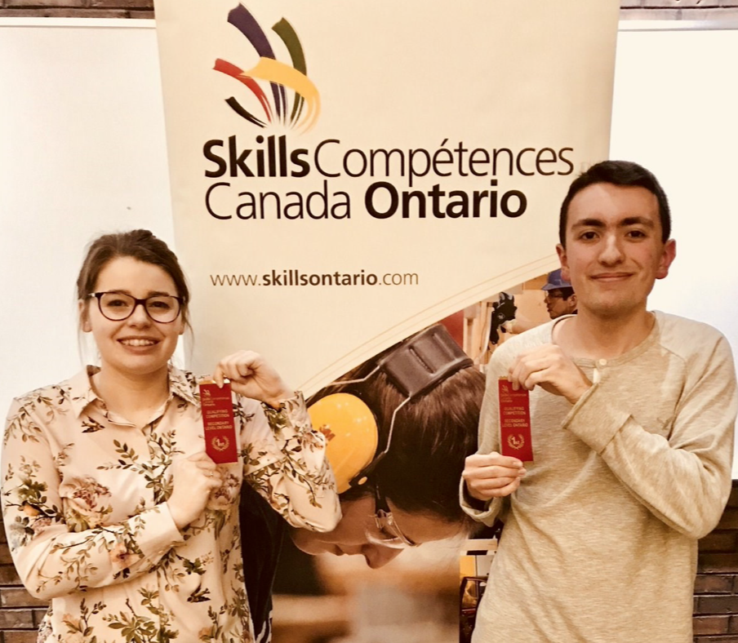
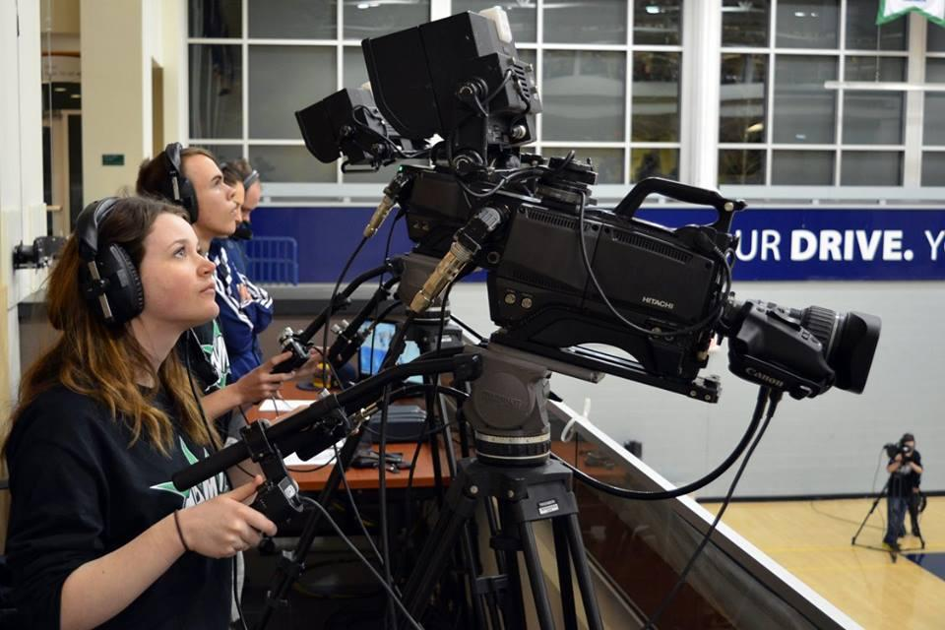
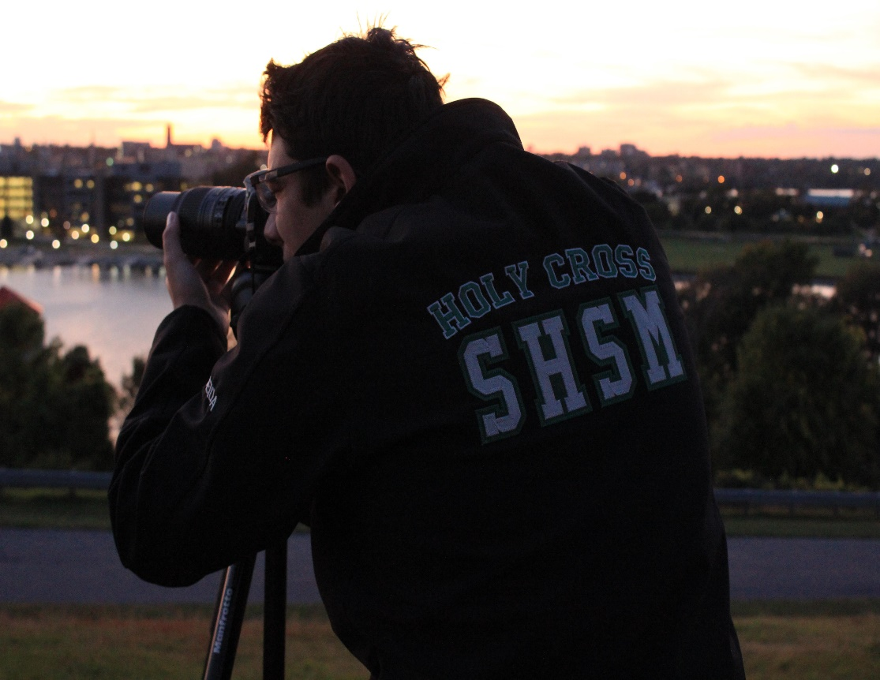
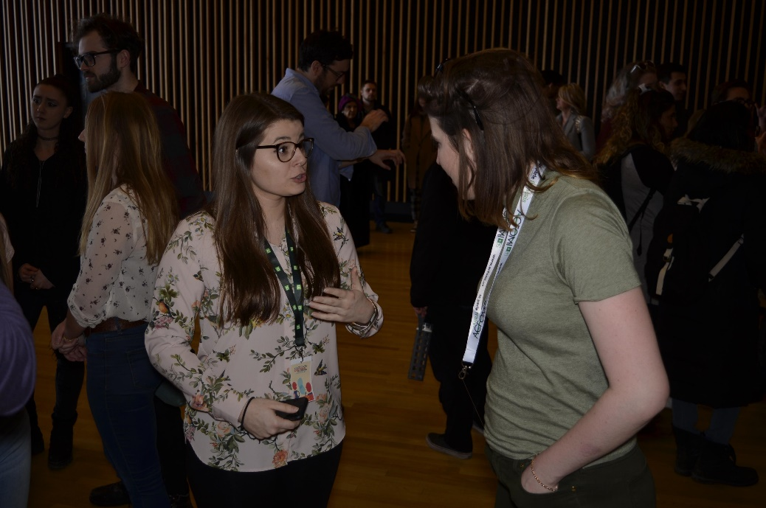
SPECIALIST HIGH SKILLS MAJOR
(SHSM)
Notes:
-The tech S.H.S.M offers a variety of opportunities for the students to explore careers in tech such as photography, film, graphic design and so much more. -It also offers an opportunity for all students to express themselves in unique and modern ways
-Most of the students work is displayed in and outside the Com Tech Room, so other students and staff can be inspired
-The students get special certifications in CPR and First Aid, I.C.E Training, and Fall Protection and even get to shoot real sport events with Crave T.V.
-If all the certifications are completed the students get a special red seal on there diploma which can help them get a step up in post secondary education or even a career.
-In the program the students are always top priority.
-During regular meetings students discuss what they would like the future of this program to turn out to be along with interesting actives that the group can do together.
-No voice goes unheard and all is always welcome.

Slide 11
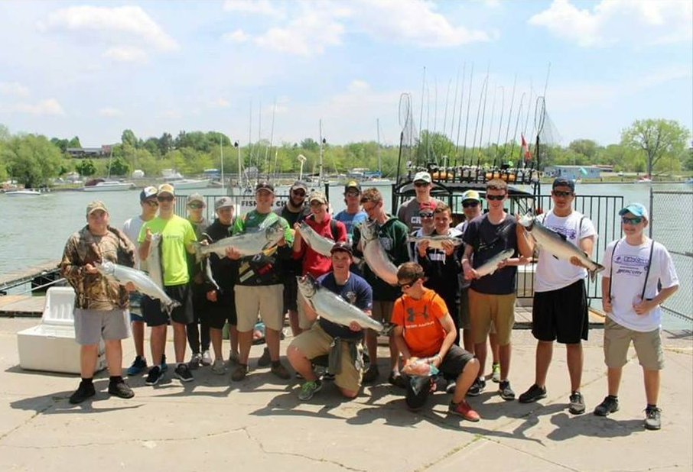
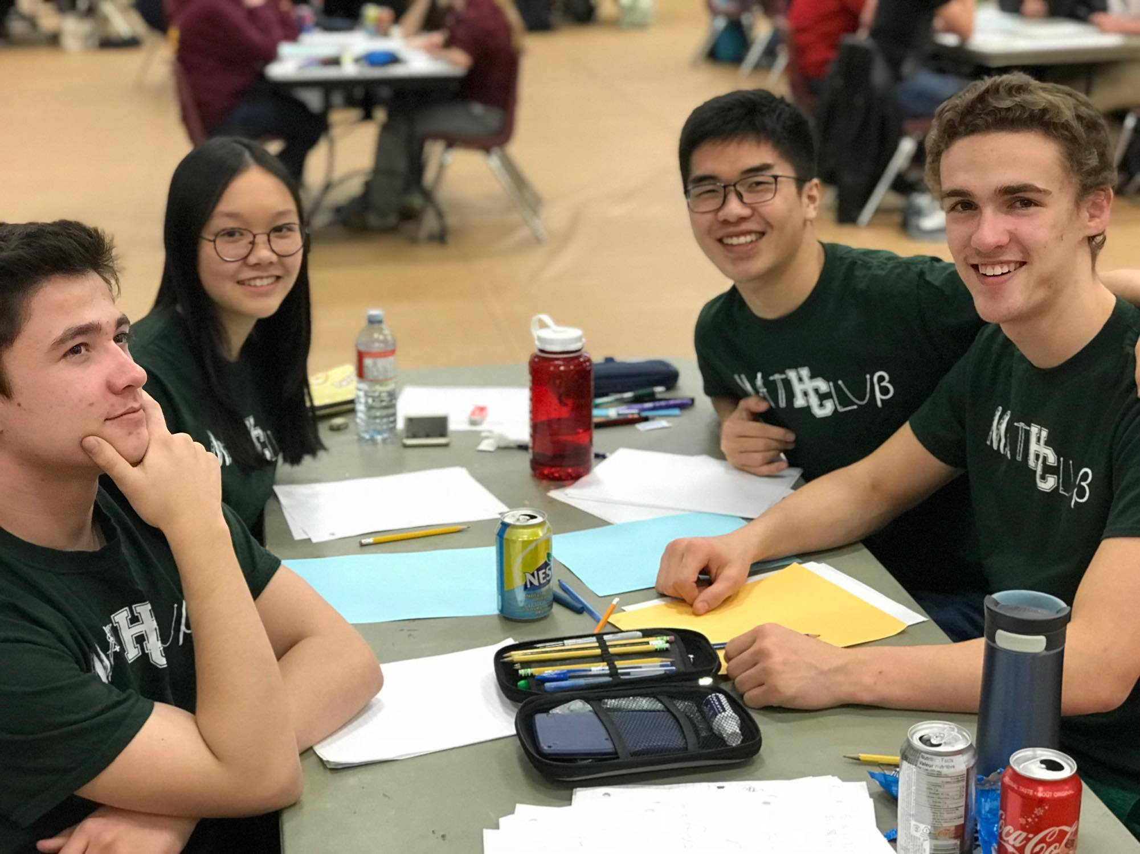

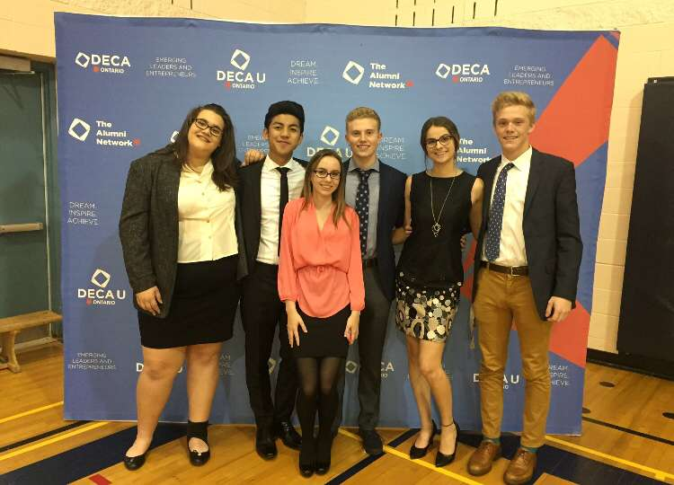
Other Clubs
Notes:
Math club, deca, dungeons and dragons, ski team, fishing club, computer science, etc..

Slide 12
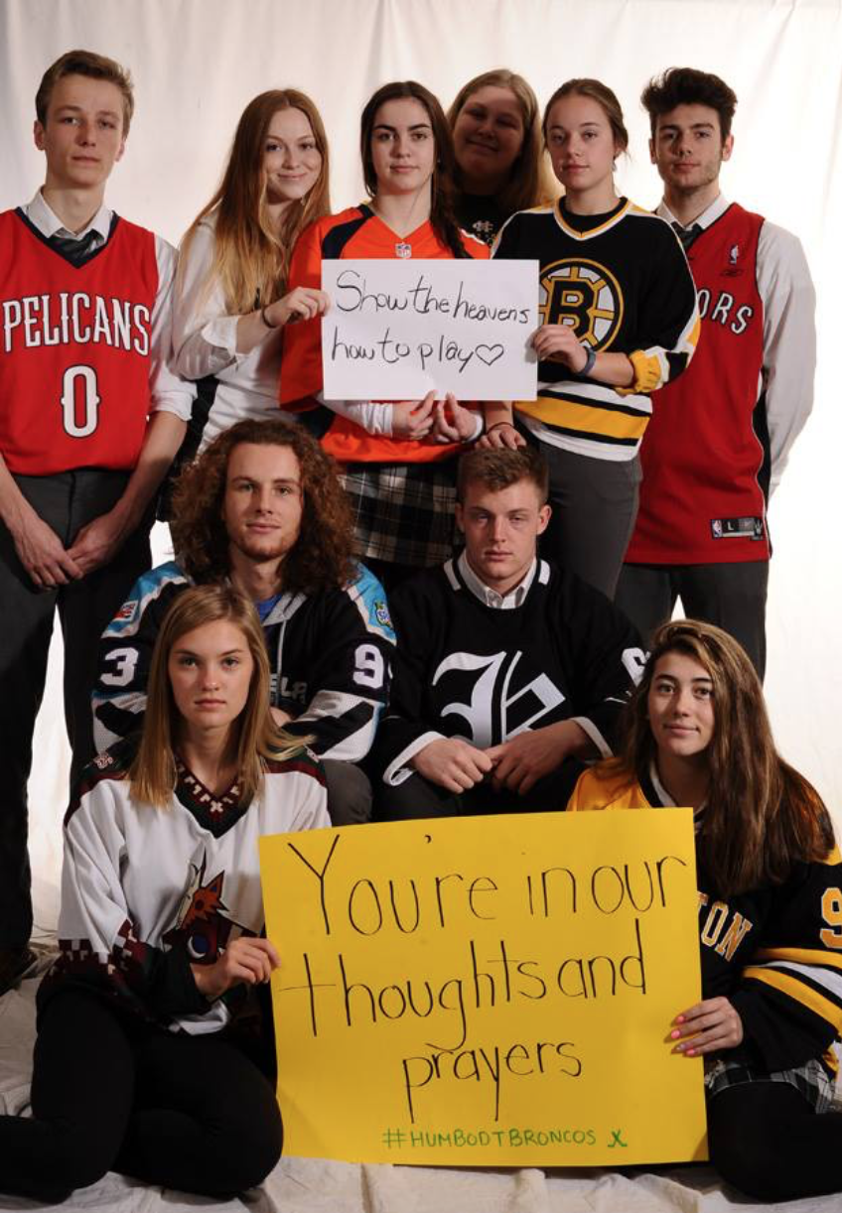
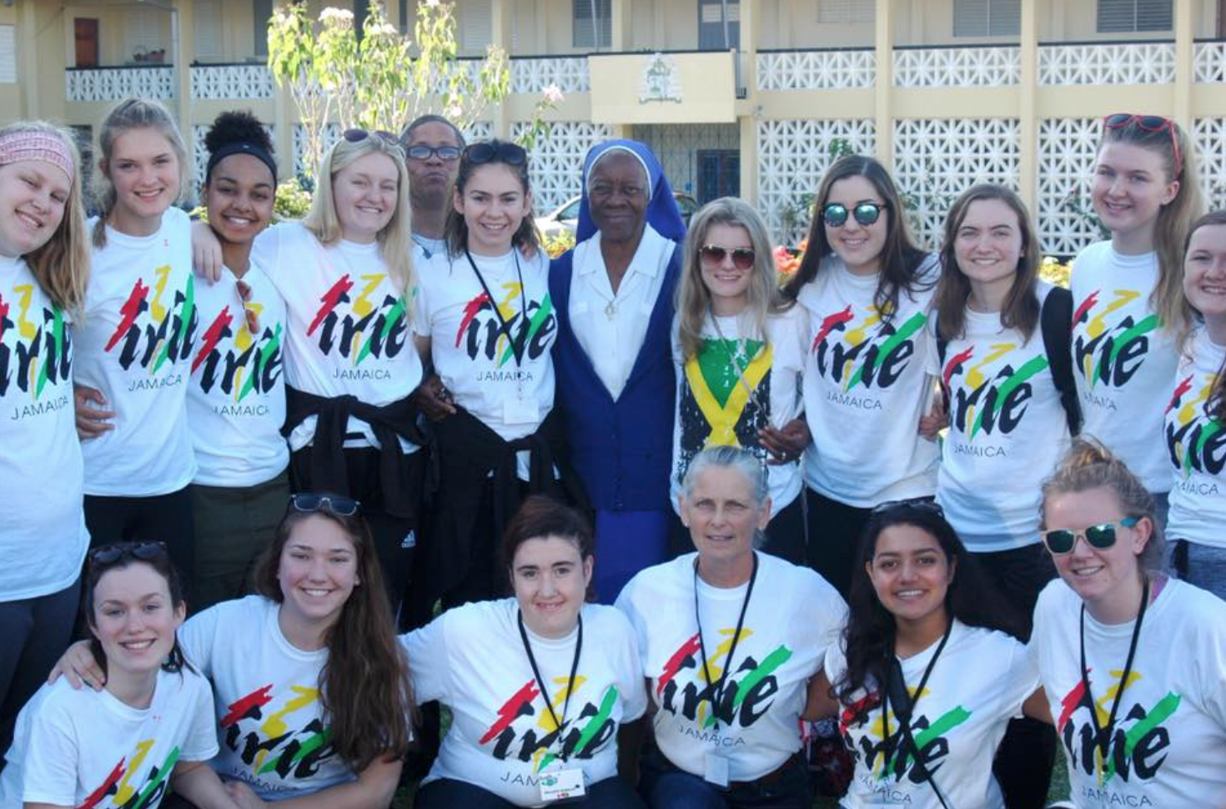
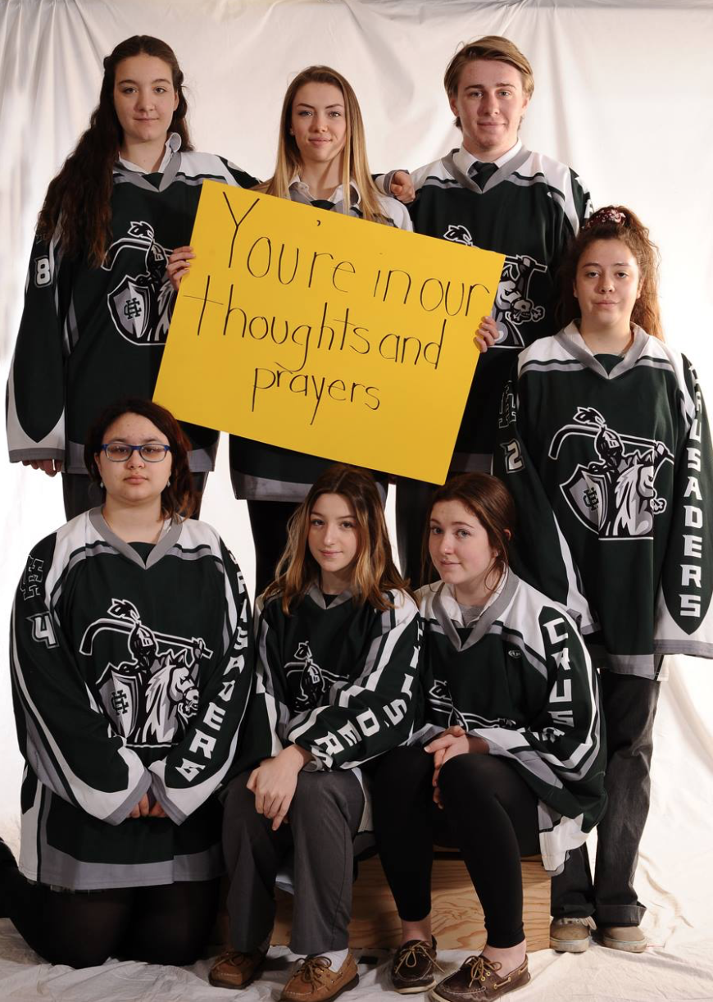
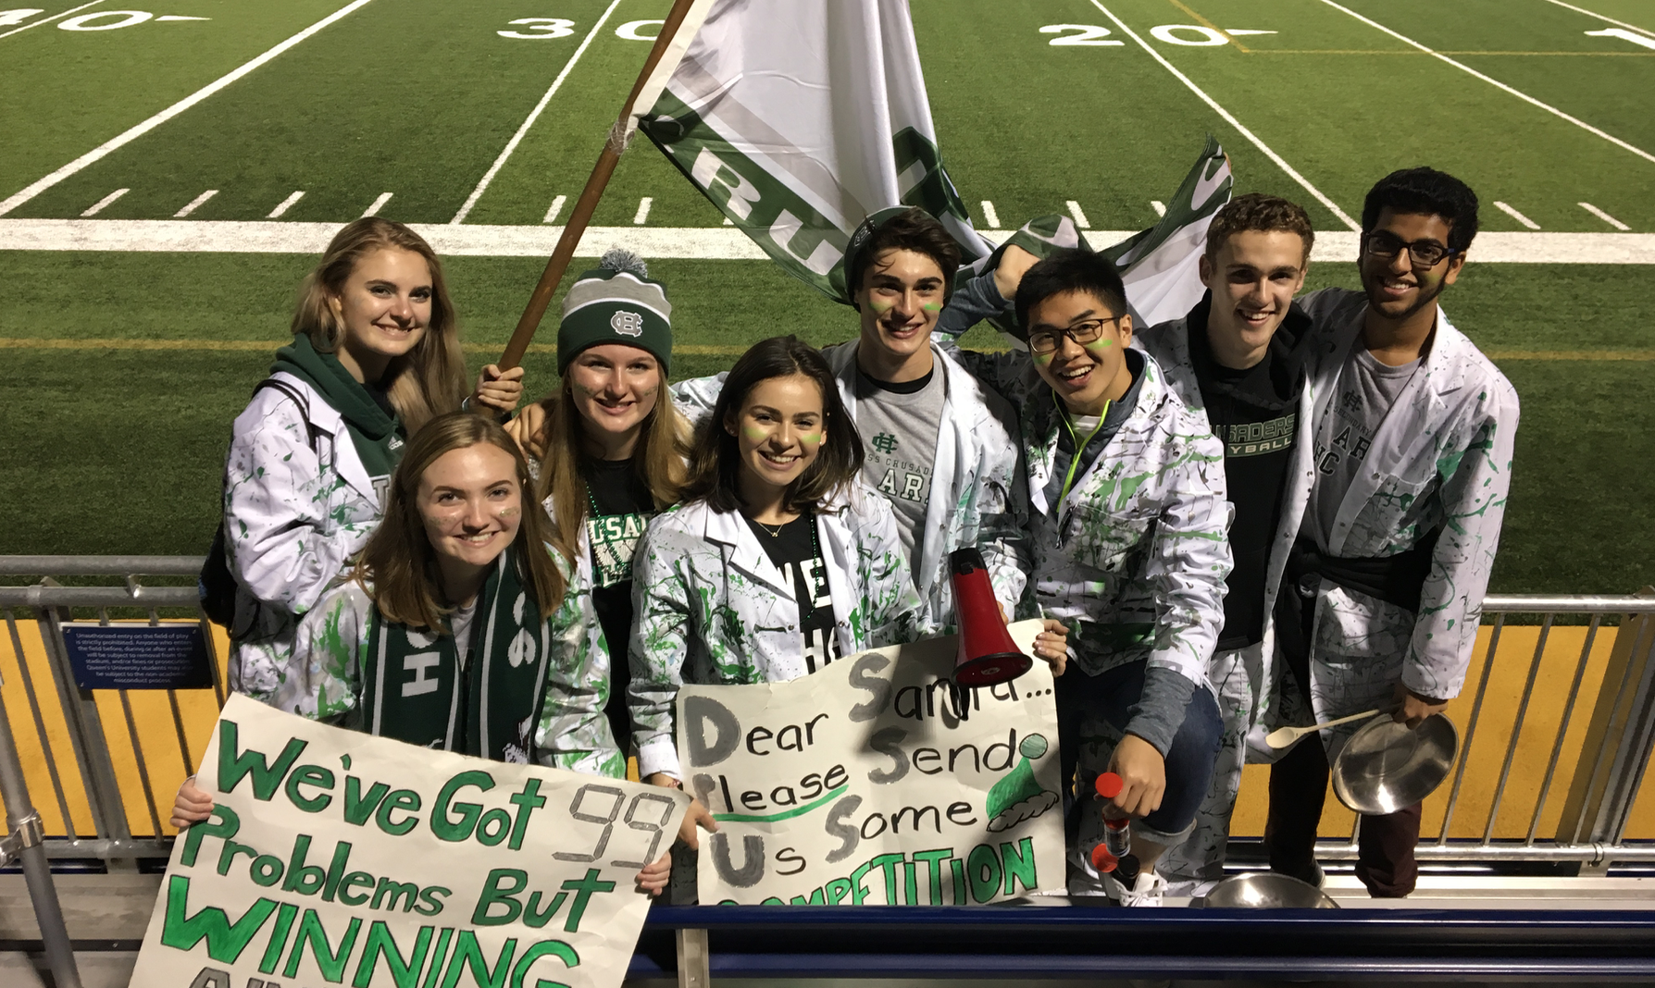
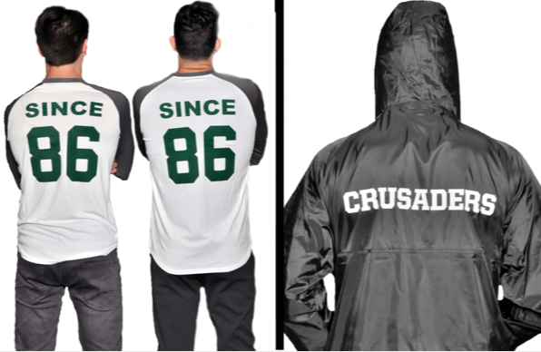
Leadership Opportunities

Slide 13

Thank-You for Listening!

