Slide 1
Being Student Trustee
By: George Hinin

Slide 2
The role and its significance
Sitting on board & committee meetings
Chair student senate meetings
The opportunity to represent nearly 12,000 students in the board.
Uniting schools in the board and bringing them together

Slide 3
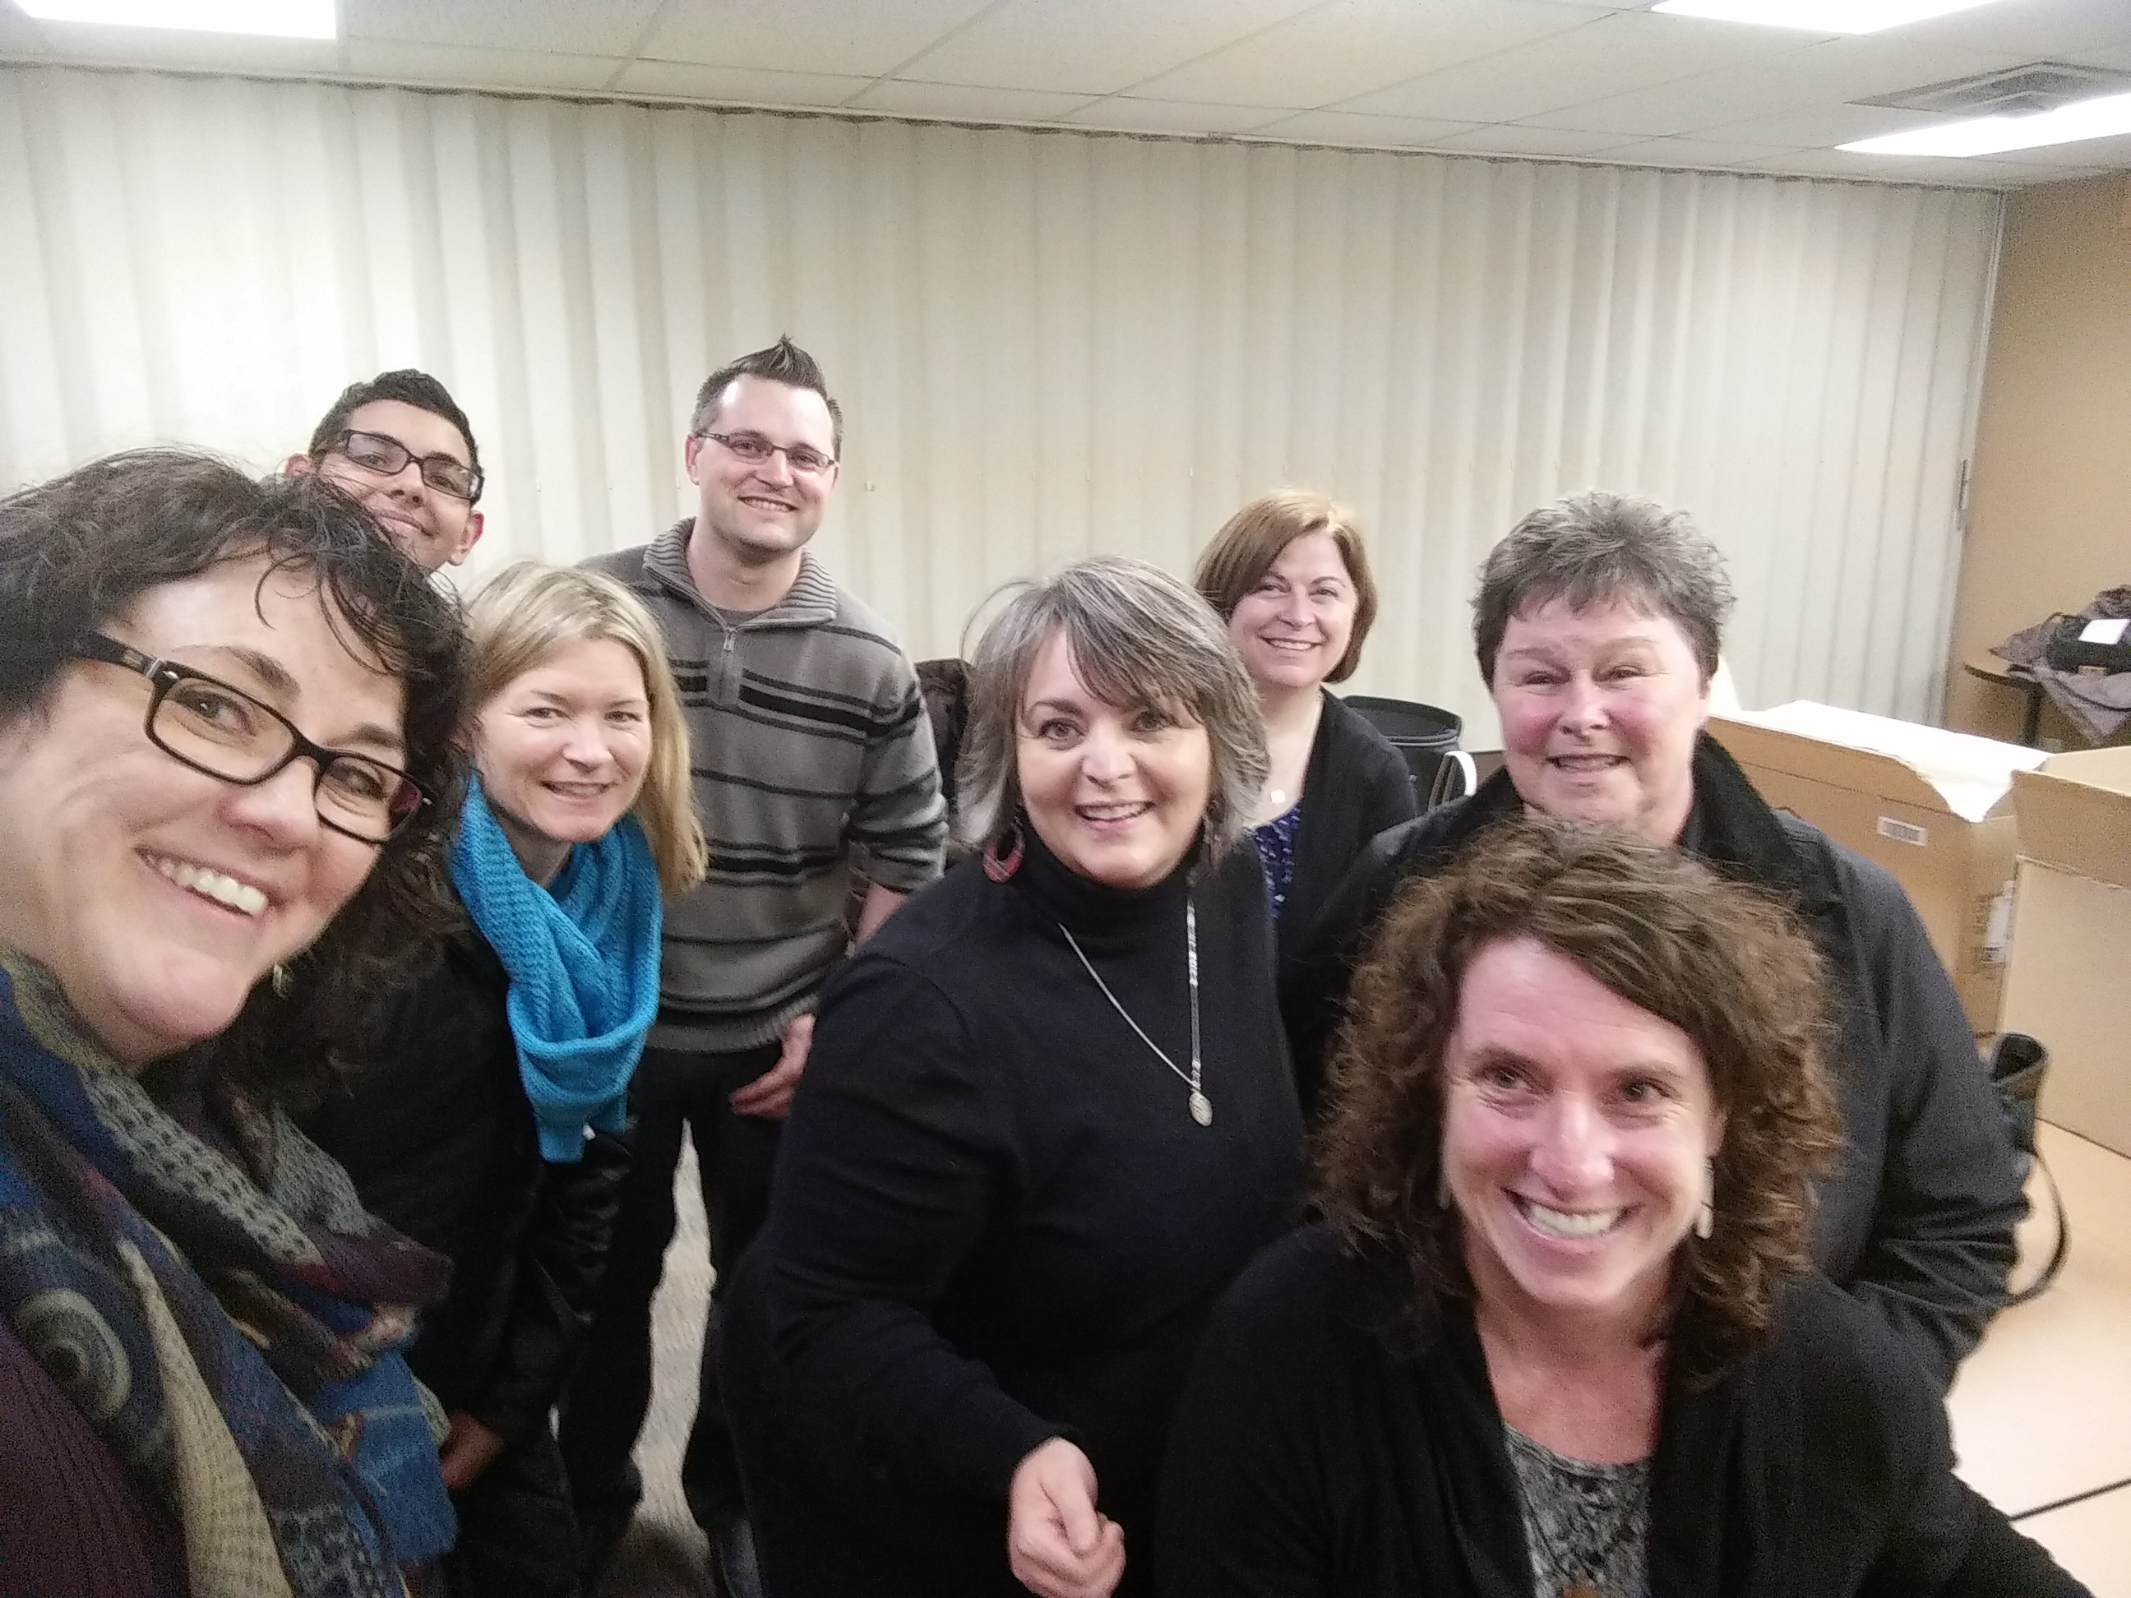
Board & Committee Meetings
The opportunity to inform students of the current questions and plans that are being implemented.
Perspective & Input
Motions
When you enjoy what you do, work becomes play. ~ Martin Yan

Slide 4
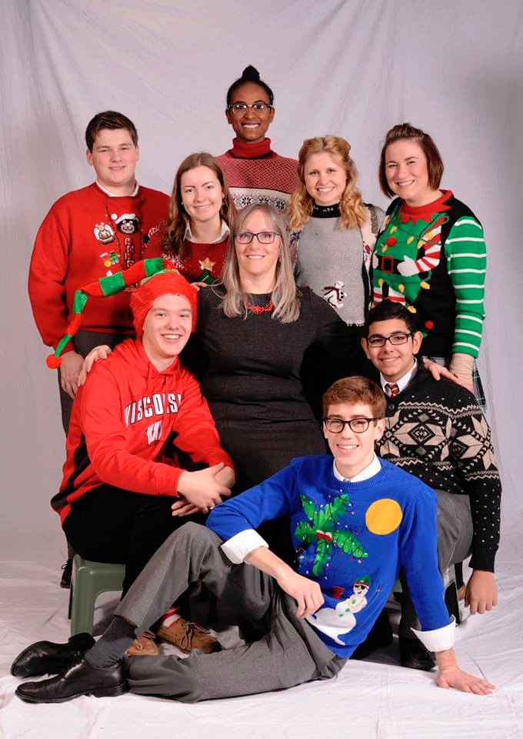
Student Senate
2 people are chosen from every high-school to represent the opinions of their respective school.
Initiatives & Change
The method by which student voice is collected and provided

Slide 5
Meeting Student Trustees all around Ontario
Significant Professional Development
Opportunity to hear how other boards work, and bring initiatives back to our board.
Policy committee

Slide 6
Excitement of the role
Understanding decisions on an executive level
Having a different experience
Visiting schools
The ability to make change.

Slide 7
What is my purpose?
Student voice
Experience changes directly
Inform students
Involve students

