Slide 1
Planning for Grade Ten
Notes:
Hello, Grade nines! Welcome to course selection for your grade 10 year. Your guidance counsellors have prepared the following slides to help you through the process.

Slide 2
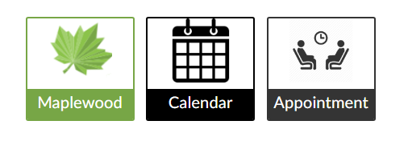
Important Icons in the Virtual Common
Notes:
Let’s begin with your RND homepage. Aspen, your Calendar, and Appointments are useful for keeping you on track academically. Aspen is our Student Information System. This houses your timetable, you marks, and what you need to graduate with an Ontario diploma. You should be checking Aspen on a regular basis. The calendar can help you track appointments, course work, and extracurriculars. It’s never too early or too late to get organized. The Appointment icon connects you with Student Services. It is very straightforward. However, if you want help booking your first guidance appointment head into our office for instructions.

Slide 3
Gateway to Guidance
1. Check your ALCDSB email daily.
2. Download the Outlook App.
Notes:
Another important icon is Outlook. Here you access your Board email. It is important that you start checking your account daily. This is how we communicate with you and how colleges and universities will as well in a few years.

Slide 4
Ontario Secondary School Diploma
Total of 30 credits
18 compulsory subjects
12 options or electives (4 must be religion credits)
40 hours community involvement
Ontario Secondary School Literacy Test (Reading and Writing)
Notes:
In order to graduate from high school in Ontario you need to earn 30 credits – 18 compulsories (such as English, math, and science) and 12 elective or optional credits. You must accumulate at least 40 hours of volunteerism before the end of grade 12, so be sure to bring any hours you have into Student Services. Last but not least, you must pass the OSSLT. Typically it is written in the Spring of your grade 10 year, and don’t worry because Ms. De Vuono and the Literacy Team will make sure you are more than prepared.

Slide 5
What will I take in Grade 10?
Religion
English *
Mathematics *
Science *
Canadian History *
Civics {.5 credit}
Careers {.5 credit}
TWO ELECTIVE COURSES
Notes:
Grade 10 is fairly limited in the choice of what you study. You must take all these courses plus two electives. This year, you will need to choose a level at which to study the courses that have an asterisk beside them – either academic, applied, or locally developed. If you take French in grade 10, it will count as one of your electives. It is not unusual for students to take civics and careers in summer school, (some of you may have done so already). In some cases, it gives students another elective to work with in their gr10 year.

Slide 6
Choose Courses Wisely
Consider:
Graduation requirements
Workload
If you drop a course it can be difficult to find a replacement
All program changes need parent approval
Notes:
As your guidance counsellors, we cannot stress enough the importance of making realistic, informed decisions about what courses you will take. Picking courses that your friends love? Not a great rationale for your choices. You must ask yourself – how hard will I need to work, will that give me balance within my timetable, how serious am I about that particular pathway, what am I interested in or curious about? It is not always easy to drop a course and find a good replacement during the school year. These questions will help you make the best choices for your grade 10 year. Last thing to bare in mind is that you cannot choose to change a level for a course or remove yourself from a French or the IB-prep program without parent approval. This is the case until you turn 18.

Slide 7
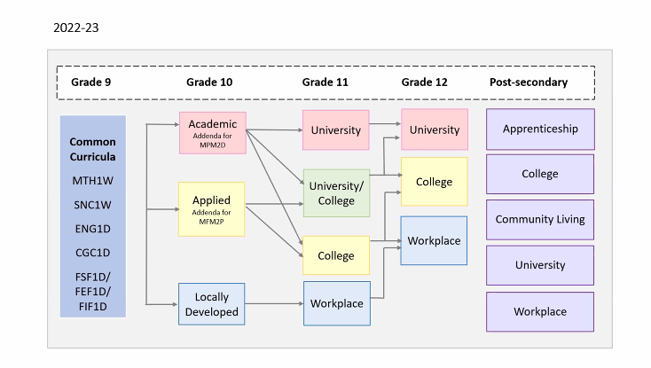
What MATH level should I take?
Notes:
This is an important question for several of your courses this year, as students move from provincially de-streamed courses into streamed ones for grade 10. let’s use math as an example. Keep in mind that academic math leads to the university pathway in the senior grades; whereas, applied level math leads to the college pathway in the senior grades. If you took locally developed math in grade 9, you will take locally developed math in grade 10. Be sure to reach out to your classroom teachers and your guidance counsellor if you need more information about pathway planning.

Slide 8
Immersion Program
Required Courses (I):
French Language Religion Careers/Civics History
Phys. Ed.
A total of 10 courses by the end of gr.12
Notes:
Students who are in the immersion French program must take FIF2D (your French language class) plus credits in French such as religion, history, and coed gym. Civics and careers is also an option but it will only be offered in summer school. You must take a total of 6 courses taught in French, along with your FIF class each year to receive your Certificate of Proficiency in Immersion French at Graduation. That's right a total of 10 courses.

Slide 9
Extended Program
Required Courses (E):
French Language
Choice of Religion,
Civics/Careers,
History, and Phys. Ed.
A total of 7 courses by the end of gr.12
Notes:
Students who are in the extended French program must take FEF2D (your French language class) plus credits in French such as religion, history, and coed gym. Civics and careers is also an option for extended and will only be offered in summer school. You must take a total of 3 courses taught in French, along with your FEF class each year to receive your Certificate of Proficiency in Extended French at Graduation. That's right a total of 7 courses.

Slide 10
Grade Ten Electives
Arts Course (Music, Visual Arts, Drama) Tech Course (ComTech, Construction, Health Care/Cosmo)
Business Course (Intro to Business)
Language Course (French, Spanish)
Phys.Ed Course (Healthy Active Living)
Notes:
There are more elective options available to you in grade 10. Most of you will choose two courses; some of you will choose three. One important point to keep in mind is that this is your wish list. We hope that everyone gets every course selected at this time; however, the reality is we don't know where courses will sit in the 2022/23 schedule yet. Once this schedule is built then we see if your wish list comes true.

Slide 11
Reaching Ahead Grade 11 Courses
Benefits of Reaching Ahead:
Flexibility
Enrichment
Considerations:
Work habits
Timetable constraints
Creating “gaps”
Ability to deal with stress
Notes:
Some students, in consultation with their parents or guardians and guidance counsellors, will choose to reach ahead by taking a gr11 course. There are several good reasons for doing so. There are also a few reasons why you might want to wait. For example, >>>> Many gr10s get cold feet when they are about to start those courses or find them more challenging than they anticipated. Bare in mind that if you pick a course, it may be very difficult to replace it during the school year. A grade 10 student will never take a spot in a gr11 class over a student who is in grade 11. Also, please note that under no circumstances can a gr10 student choose to take a gr11 course instead of completing a gr10 compulsory credit in their gr10 year.

Slide 12
MyBlueprint
Online research & planning tool
Helps students career plan
Access it by clicking
in Virtual Common
Notes:
At RND we choose our courses using MyBlueprint, which you will find on your RND homepage, or in the Virtual Common. Many of you have used it before, but a refresher of the process never hurts. For those of you who have not used MyBlueprint before now, it is very straightforward and your guidance counsellors are here to help.

Slide 13
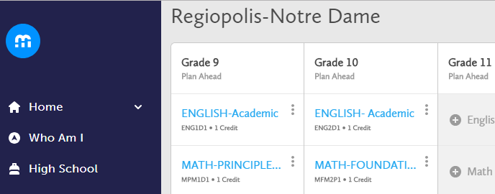
Using MyBlueprint
1. Create Plan under “High School”
2. Choose levels
3. Add Courses
4. Review & Submit
Notes:
Once you click the MyBlueprint link in the Virtual Common, you will start at the Dashboard. On the side tab, you will choose "High School". This will take you into your planner. You will be able to see this year's courses and your final grades at this point. You will start with English, choose your level – academic, applied, or locally developed, then add the course. Once you have done so, it will appear in blue on your plan. Then move to the next subject – math. You will choose a total of 8 courses. Unless you choose to take civics and careers during the school year then you will choose a total of 9 courses because civics and careers are half courses. Once you have chosen your courses for next year, be sure to have your parents review your selections then hit submit. Your class will meet as a group with the guidance counsellors on your designated day. Your classroom teacher can share that with you. That means you do not have to do this alone. We will guide you through the process. After your meeting, we encourage students to book appointments with your guidance counsellor to have any questions you might have answered.

Slide 14
Summer School
Registration happens in April/May
Sign up through Student Services

Slide 15
Frequently Asked Questions
Can I show my parents my choices in myBlueprint?
Yes, discuss your plan for grade 10 with your
parent(s)/guardian(s), and have them digitally sign.
2. Do all of my courses have to be the same level?
No, you can take a combination of levels. However, there are some things you need to consider. Speak with your guidance counsellor.
3. Is there a deadline for course selection?
Yes, two weeks after your visit to Student Services.
4. Can I change courses after they are submitted?
Yes, but your guidance counsellor must do it for you.
Notes:
On that note – here are a few questions we always get from students. We know this is a great deal of information but Student Services will make sure you all get through this process as efficiently as possible. Thank you for your attention today. We will see you all very soon.

