Slide 1
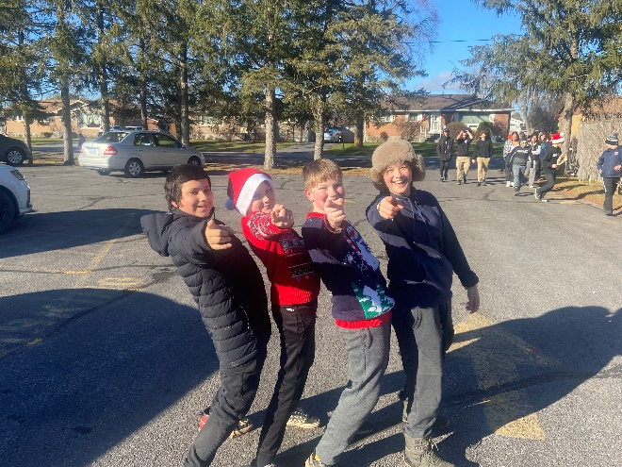
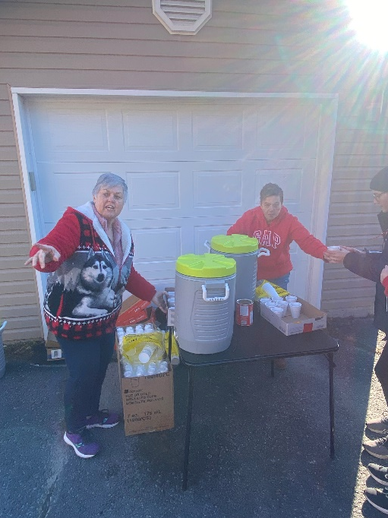
Our lady of mount carmel Catholic School Council
Love – Learn – Respect
Aimer – Apprend - Respect
Monday January 23, 2023

Slide 2
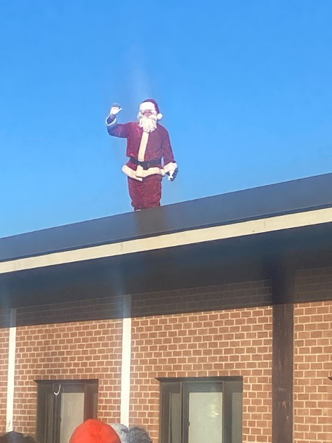
Celebrating recent events
Senior Girls Volleyball A school Champs
Class Skating trips
Pickle ball trips
National Colouring Contest winners
Grade 2 Sacrament preparation and enrollment ceremony last week (& tonight)
Jungle Bell Walk huge success
again (Santa did not fall from the
roof – lol)

Slide 3
Upcoming Events
Wed. Jan. 25th Boundary Consult Meeting 6:00-7:30
MDI school Climate survey (Feb./March)
Wed. Feb. 1st – HC visit to grade 8’s in PM
Wed. Feb. 1st – Human Trafficking Presentation for grade 7-8 in AM
Thurs. Feb. 2nd – Grade 6-8 Fundraising Dance
Fri. Feb. 3rd – PA Day
Tues. Feb. 7th – Junior Co-ed Road Hockey Tournament
Mon. Feb. 13th – French Café – Grades 1-2
Tues. Feb 14th – French Café – Grade 4-8
Tues. Feb 21st – Term 1 Report Cards and IEP’s go home
Tues. Feb. 21st – Shrove Tuesday, Senior Boys Basketball (HC)
Wed. Feb. 22nd – Ash Wednesday Mass at 9:30
Wed. Feb. 22nd – Pink Shirt Day – Be Kind to you and All
Fri. Feb. 24th – Senior Girls Basketball (HC)
Feb. 27th – Junior Boys Basketball (McArthur College)
Feb. 28th – Juniot Girls Basketball (McArthur College)
Tues. March. 7th – First Confessions grade 2 and some 3
March 13-17 – March Break
Wed. March. 22nd – Grade 8 Grad Pics
Wed. March 29th – Confirmation Parent and Candidate meeting 7PM at Church

Slide 4
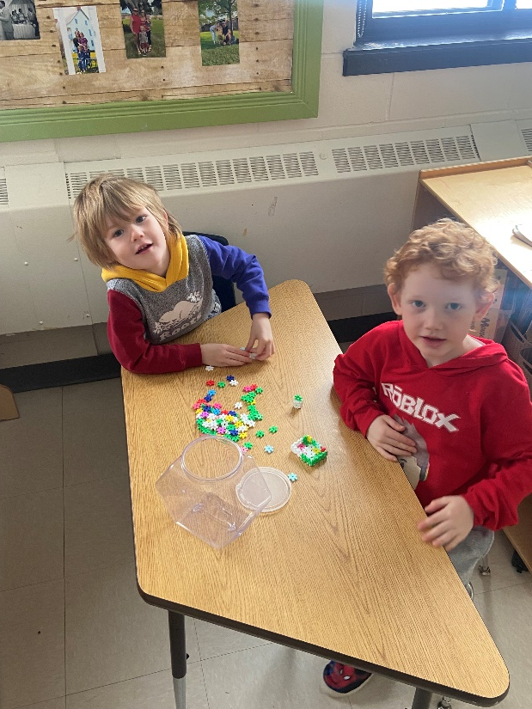
Recent School Purchases
Kinder Stationary Bike
White Boards in classrooms
Items for sensory room
Blind install (1/2 paid by board)
Large order of class items for McGuiness
Salt Spreader for CJ
New Volleyball Net
Headphones
New Flag
Wipe Book (Lodge Pod)
Utility Cart

Slide 5
School Photos
Feedback on delivered photo orders? Next Year?

