Slide 1
Aboriginal Education ✣ Outdoor Education
Traditional Skills Program
Notes:
Shawn:
Board of Trustees, Mr. DiRocco, Superintendents, and honoured guests,
It is a pleasure to be here this evening and to share with you information about the Traditional Skills Program that was held at the Monsignor Ryan Outdoor and Environmental Education Centre in November of this school year.
The Traditional Skills Program was developed and delivered in partnership between the Board’s Outdoor and Environmental Education Department and the Special Assignment Teacher for Aboriginal Education.

Slide 2
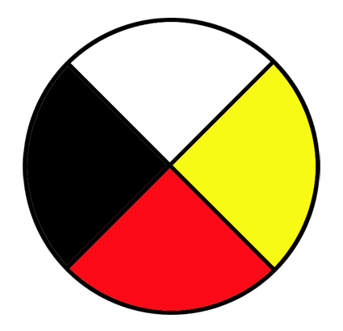
“We are a Catholic school system, called to work in partnership with home, parish and community, on our journey to understand and live the way of Jesus Christ. We are committed to excellence in Catholic education and to lifelong learning, so that those with whom we journey may become caring and contributing citizens in a world of constant challenge.”
Community
Parents
Student
Teachers
Schools
Notes:
Shawn:
As a Catholic school system, we are called to work in partnership with home, parish and community, on our journey to understand and live the way of Jesus Christ. The Algonquin & Lakeshore Catholic District School Board is committed to excellence in Catholic education and is constantly seeking opportunities to strengthen those partnerships with home, parish and community. The Traditional Skills program is an excellent example of how those partnerships can enrich the learning experience of all the students in our care.

Slide 3
Notes:
Shawn:
When we look back at the history of Canada and our relationship with the First Nations people who first welcomed Europeans into this country, I can think of no greater symbol of that shared history than the birch bark canoe. It was the canoe that brought the men and women of history to lands that were inaccessible by any other means. In this way, the birch bark canoe helped shape Canada into the country that we know today. For our students, the canoe continues to represent not only the shared history of Indigenous people and European settlers, but the enduring wisdom, knowledge and innovation of Canada’s First Nations, Metis and Inuit people. Studying the birch bark canoe honors Indigenous knowledge and provides our students with a deeper respect and understanding of First Nations contributions to Math, Science, Art, Language and History.

Slide 4
Learning and caring for God’s gift of creation through programming in, about and for the environment is one of the goals of the Algonquin and Lakeshore Catholic District School Board’s Improvement Plan for Student Achievement and Wellness (BIPSAW). The ALCDSB also supports teacher pedagogy that reflects an inquiry approach with a focus on integrated outdoor learning.
With these goals in mind, the idea for a Traditional Skills Workshop to support the Grade 5 Heritage and Citizenship: First Nations and Europeans in New France and Early Canada unit came to be.
Notes:
Mike:
Learning and caring for God’s gift of creation through programming in, about and for the environment is one of the goals of the Algonquin and Lakeshore Catholic District School Board’s Improvement Plan for Student Achievement and Wellness (BIPSAW). The ALCDSB also supports teacher pedagogy that reflects an inquiry approach with a focus on integrated outdoor learning.
With these goals in mind, the idea for a Traditional Skills Workshop to support the Grade 5 Heritage and Citizenship: First Nations and Europeans in New France and Early Canada unit came to be.
So, why a traditional skills workshop? How does this support our curriculum?
One of the overall expectations of the Grade 5 Heritage unit states that students will analyse aspects of early contact between First Nations and Europeans in New France to determine the ways in which different parties benefited. For example, early settlers benefited from First Nations people’s knowledge of medicine, geography, and modes of transportation appropriate for local conditions.
Indigenous knowledge is known as traditional ecological knowledge (TEK) and it is defined as “…the knowledge base acquired by indigenous and local people over many hundreds of years through direct contact with the environment. It includes an intimate and detailed knowledge of plants, animals, and natural phenomena, the development and use of appropriate technologies for hunting, fishing, trapping, agriculture, and forestry and a holistic knowledge, or ‘worldview’ which parallels the scientific disciplines of ecology” (Inglis, 1993, vi). With this in mind, traditional skills are the application of experience based practices critical to the identity and survival of culture and communities. With growing emphasis on technology and development in our world traditional ecological skills are rapidly becoming endangered” and in need preservation.
Now, why a traditional skills workshop in November?
In the Catholic faith, November is a time of remembrance. On All Souls Day, we remember and pray for those who have departed, that they may find complete unity with God. On Remembrance day, we recall and are grateful for those who gave their lives in the service of peace and freedom. Our gratitude is expressed through Church and family traditions, in meaningful songs, and in the stories that we share of our loved ones.
For the Anishnabek people, November is the time of the freezing moon and also the time to remember our ancestors. It is the time when sacred waters begin to cover with ice. When creation begins to slow down and start its winter slumber. This moon reminds us to slow down and rest so that healing can occur in our lives. It is a time to share knowledge and stories from the past. A time to “mend” and be grateful.
For our Grade 5 students, November provides a perfect backdrop to compare and contrast early communities in Canada. As we learn about technology from Indigenous and European perspectives, we are also able to compare the differing perspectives on social and environmental issues. November at the Ryan Centre provides us with a unique opportunity to honor our Catholic faith traditions and to recognize the seasonal traditions of Indigenous communities. We are invited to slow down, remember, and learn together in community.
(Intrtoduce Danka Brewer)

Slide 5
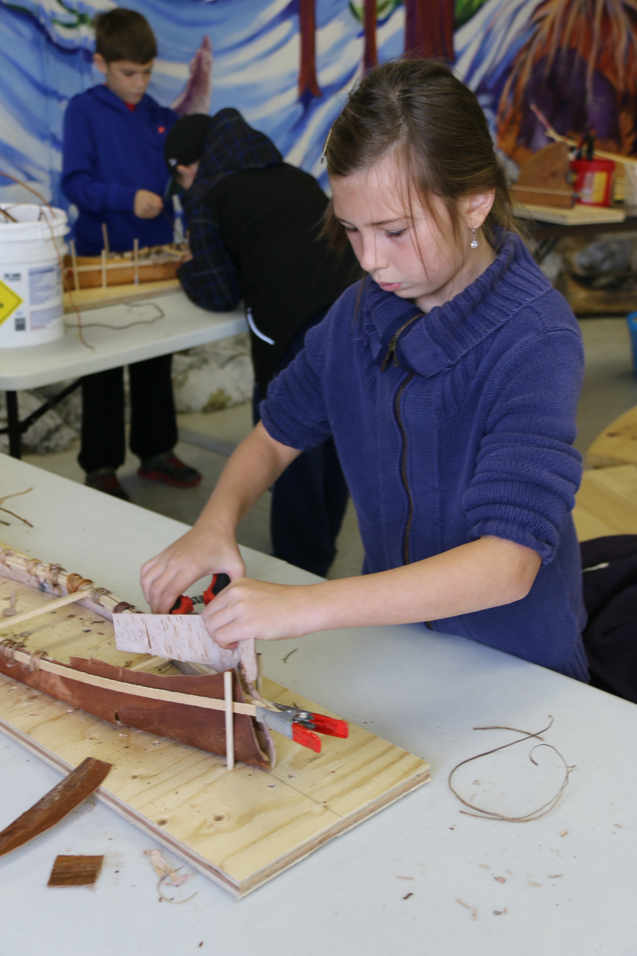
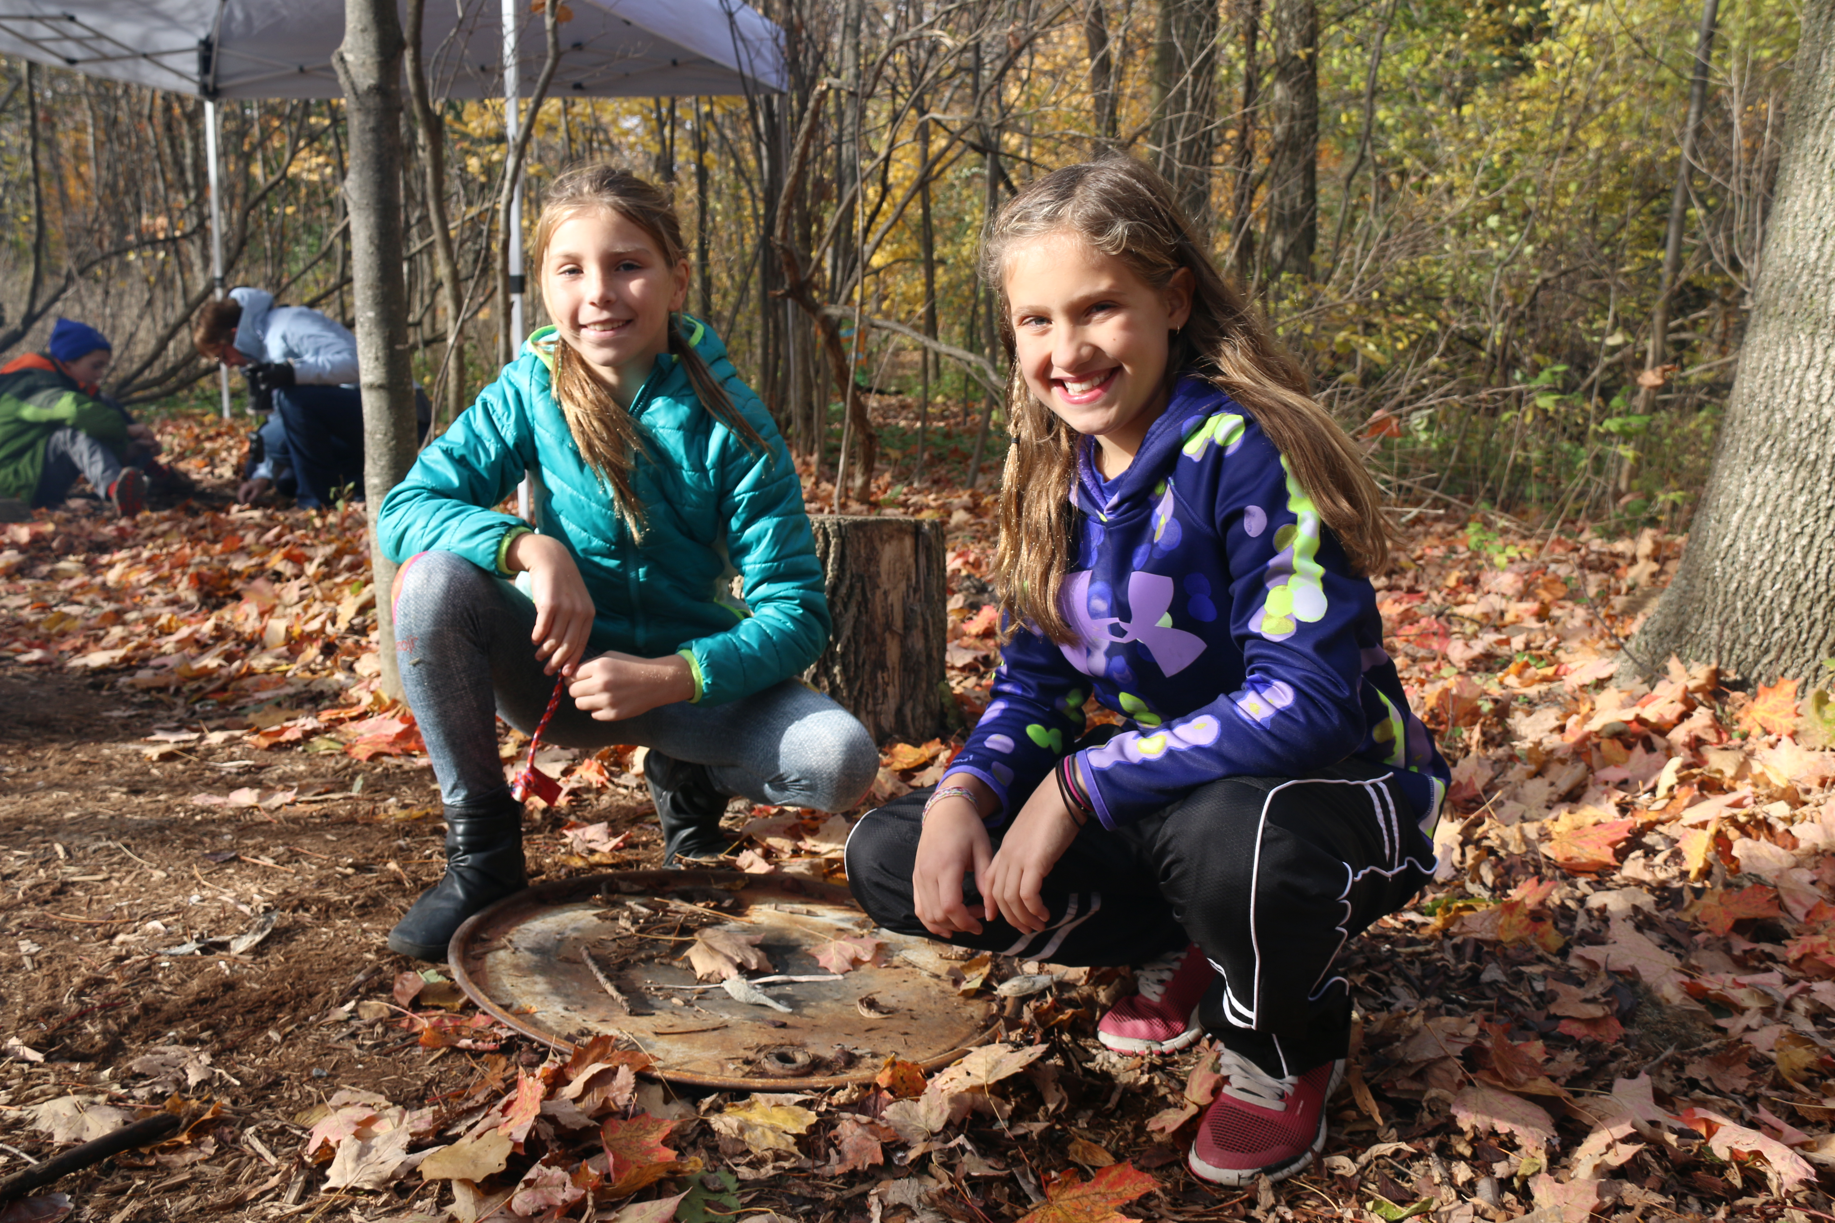
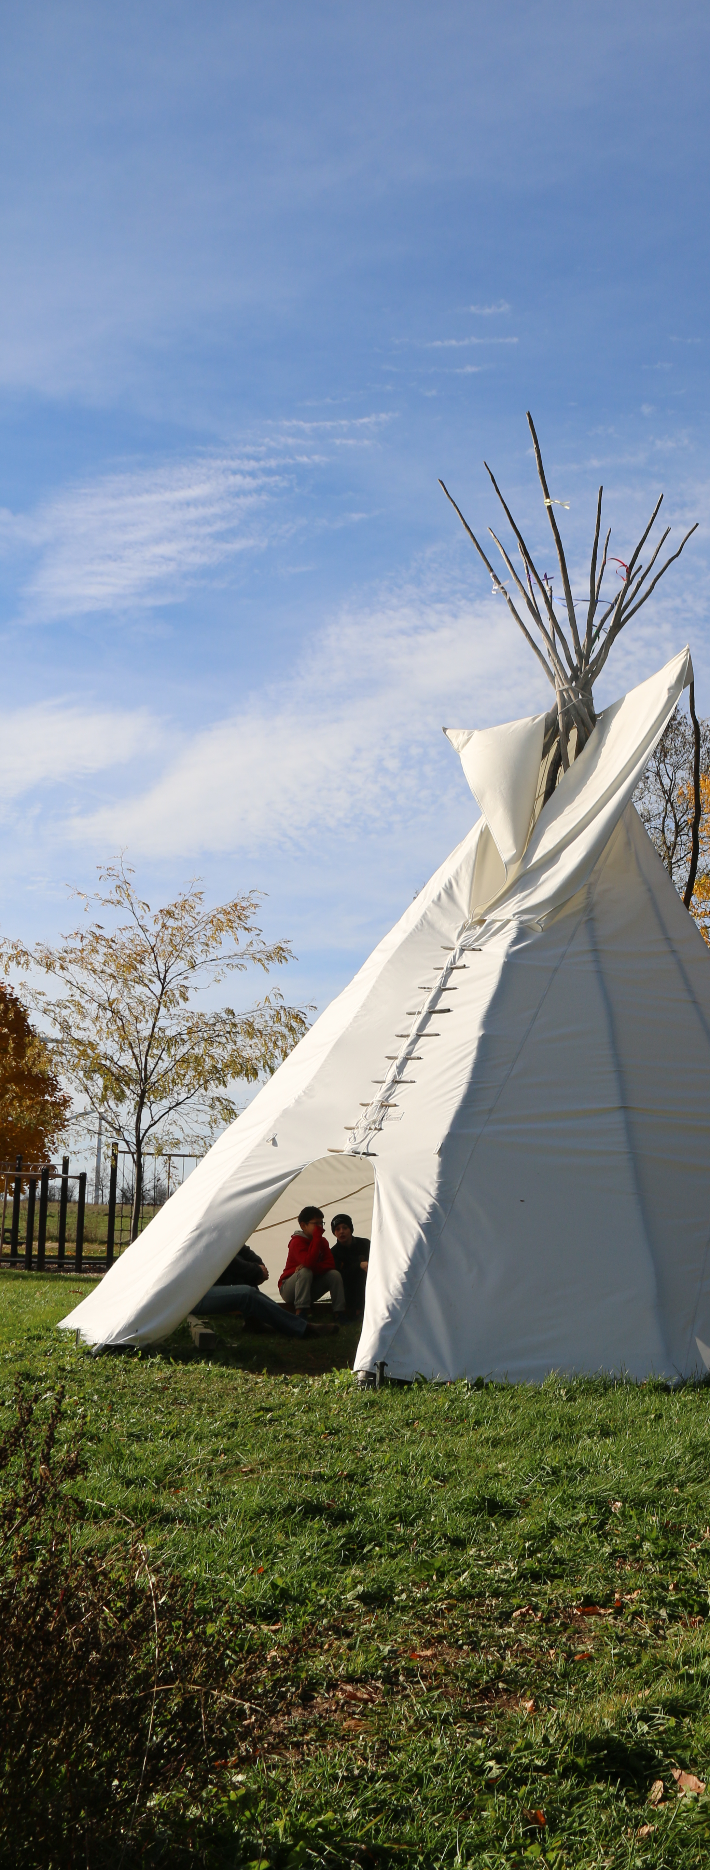
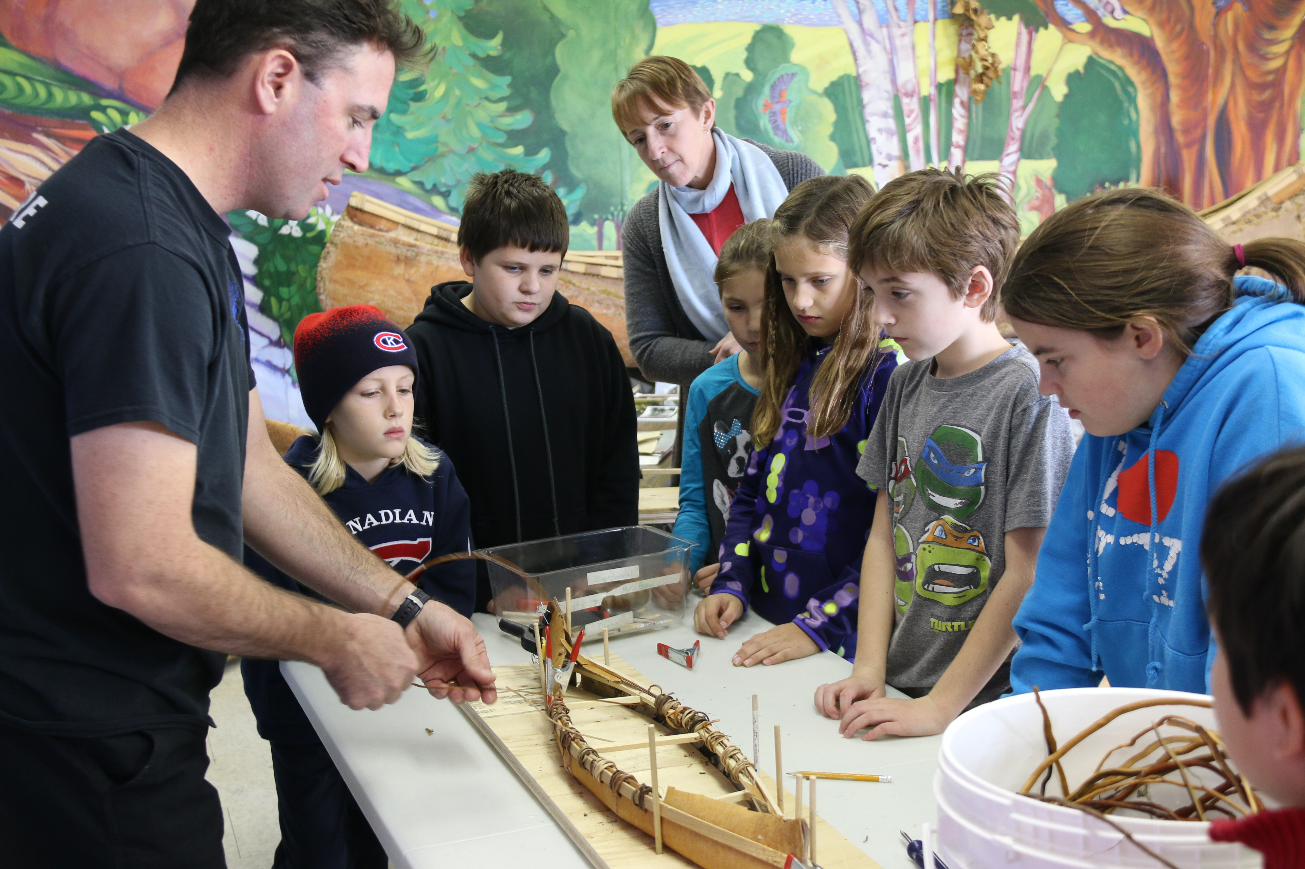
Notes:
Student & Teacher Experience

Slide 6
Chiimaan means canoe…
Student video goes here…
Notes:
Video created during the Take Your Child to Work day in November.

Slide 7
Aboriginal Education ✣ Outdoor Education
Traditional Skills Program

