Slide 1
Notes:
Spanish Version found on pages 19-34

Slide 2
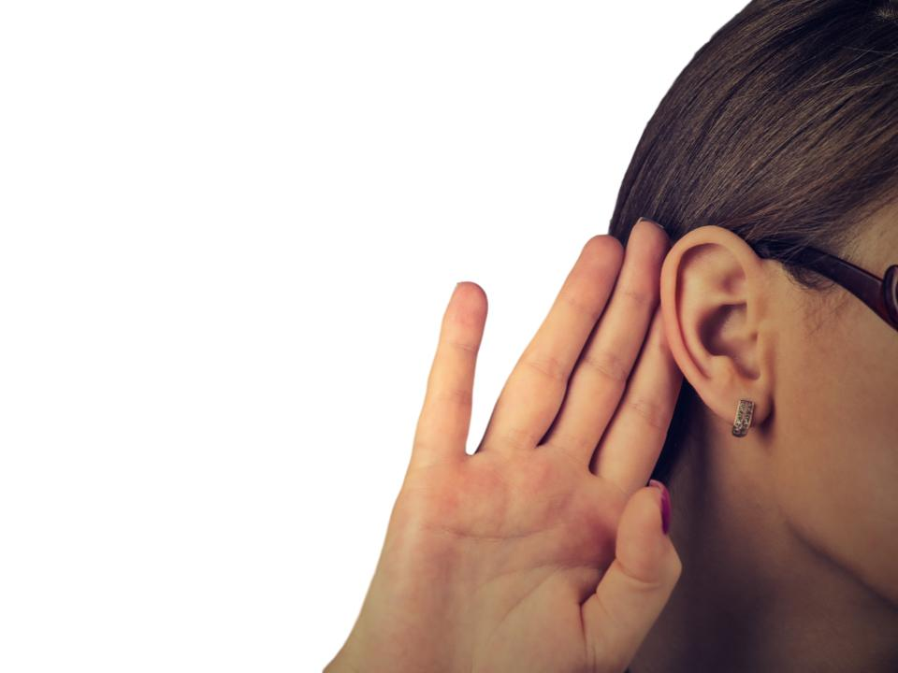
I am hearing a lot of people
talk about COVID-19.

Slide 3
COVID-19 is a virus.
Viruses make people sick.

Slide 4
COVID-19 can give people:
A cough
A fever
A sore throat
Breathing problems

Slide 5
The good news is that everyone is working together to help stop COVID-19!
I can be a helper too!

Slide 6
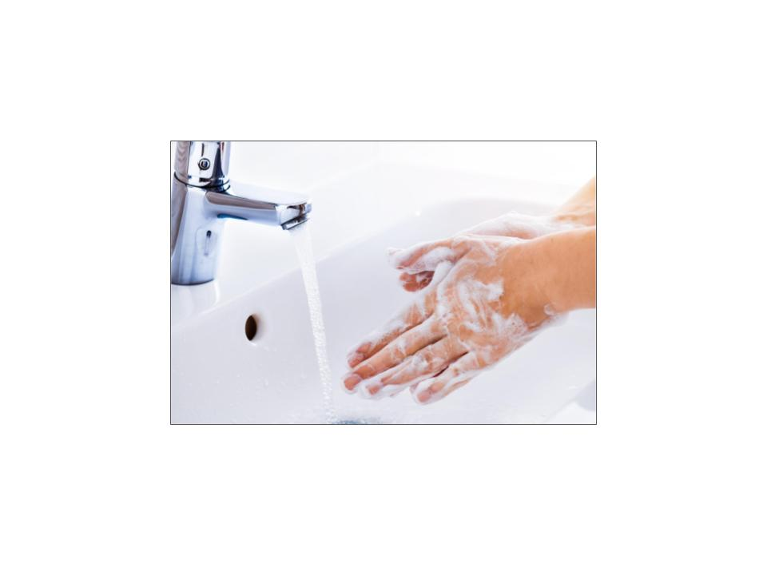
I can wash my hands a lot
to keep them clean!
When I do a good job washing my hands the germs come off of my hands!

Slide 7
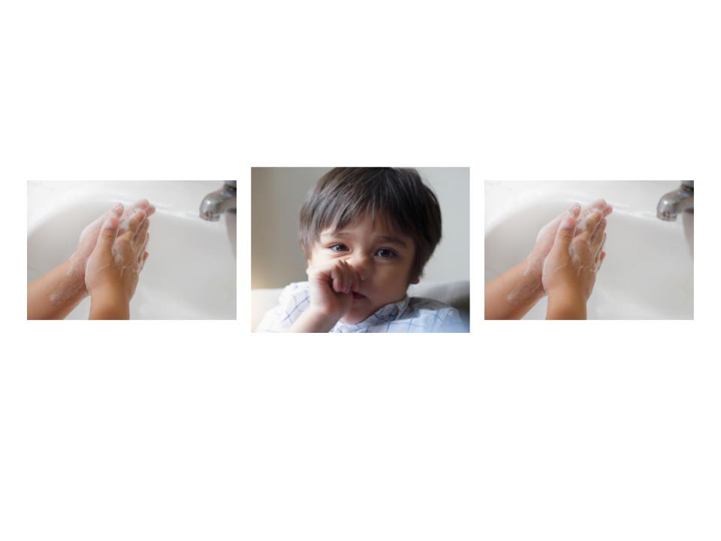
I can help to stay clean and safe if I wash my hands before I touch my nose, eyes, mouth or face.
1.
2.
3.
Then I will wash my hands again after.
Lots of washing!

Slide 8
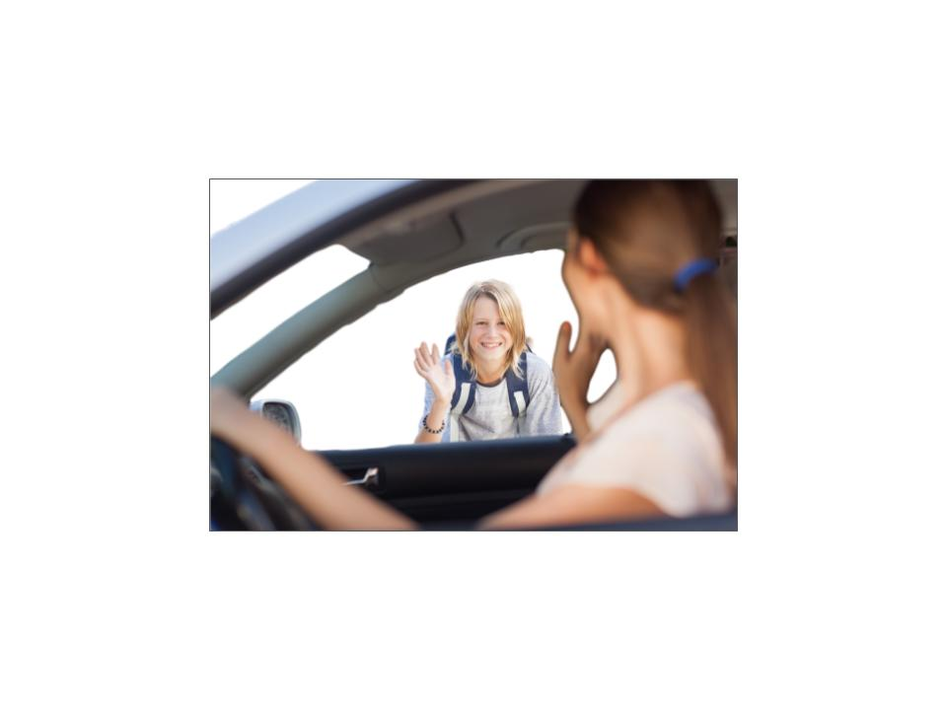
If I see people I know then I can wave instead of giving them a handshake, high five or fistbump.
Waving is friendly and it doesn’t spread germs!

Slide 9
I can help by using “social distancing.”
This just means that my family and I are going to stay home as much as possible. We will try not to be around a lot of other people.

Slide 10
Some schools are closed.
This is so students can stay home and
keep themselves away from lots of other people.

Slide 11
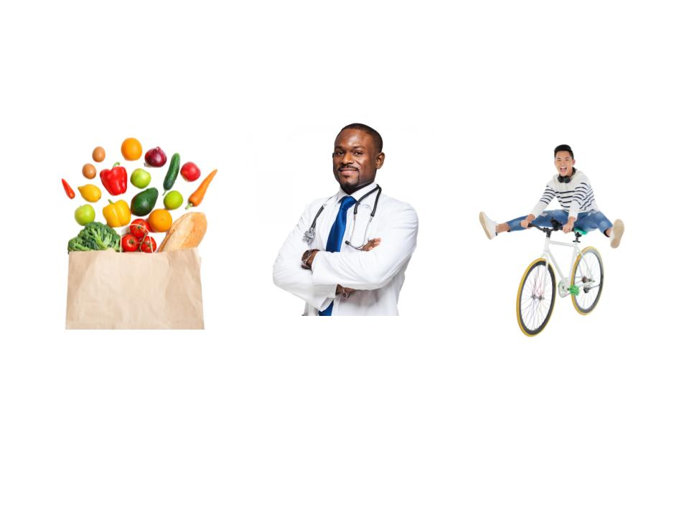
I will stay home as much as I can.
I’ll try to only leave if we need to go to the grocery store, if we need to go to the doctor, or for exercise.

Slide 12
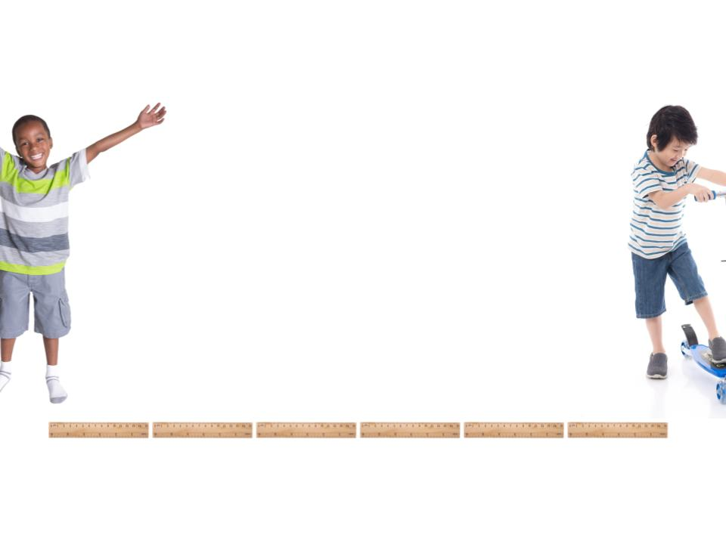
If I go outside then I will stay at least 6 feet away from other people.
That’s like six rulers away!

Slide 13
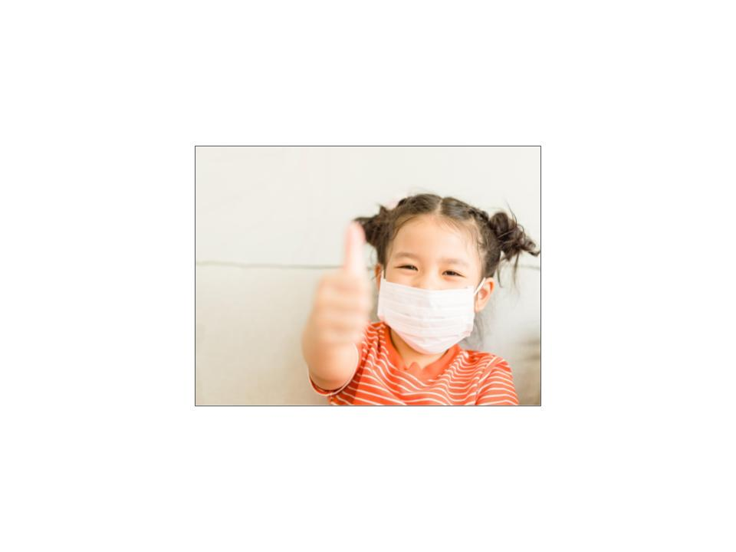
I see some people wearing a mask. That is to help keep germs out of the air if people cough.
If I get a cough then I can wear a mask too.

Slide 14
Now I know what to do:
Wash my hands a lot.
Try to say home as much as I can.
Stay at least 6 feet away from people I don’t live with.

Slide 15
It can be hard to stay away from my friends and other fun places, but I know that I am helping to keep myself and other people safe.

Slide 16
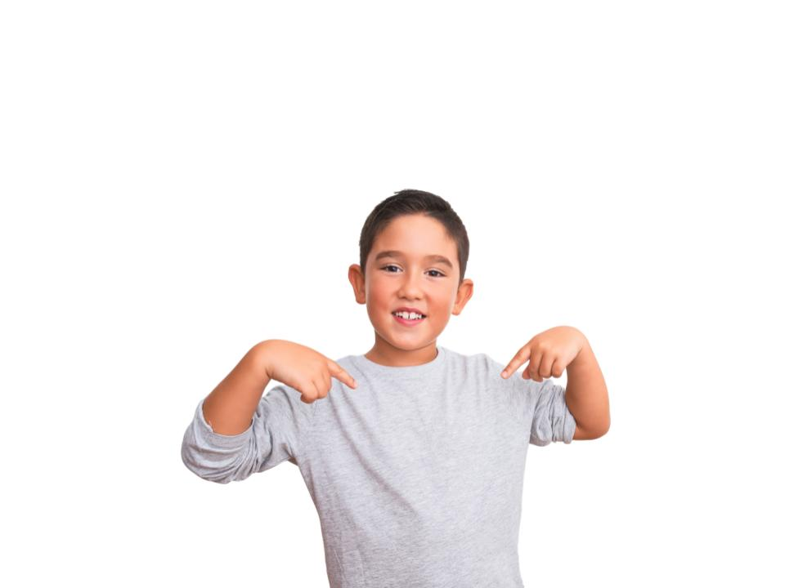
I’m a great helper!

