Slide 1
St. Theresa Catholic Secondary School
Presented by: carley Vinkle, corinna reichinger, mrs. Smith-dewey and student council representatives

Slide 2
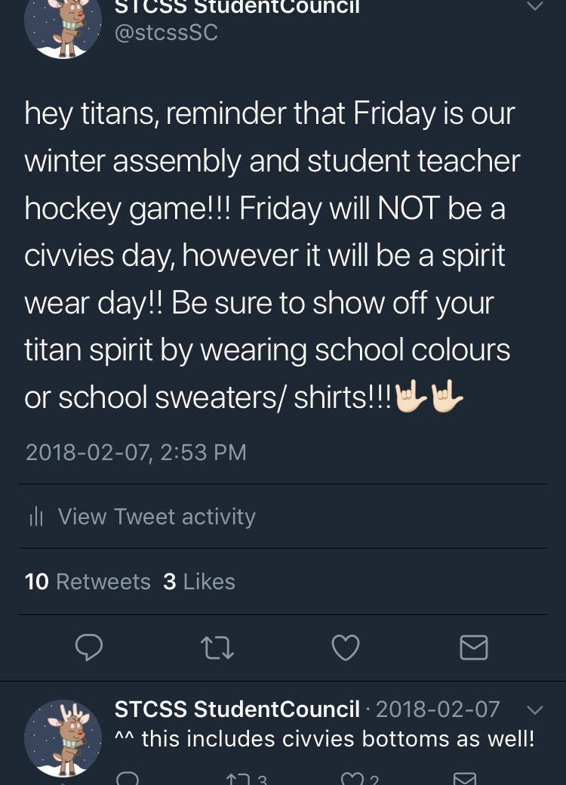
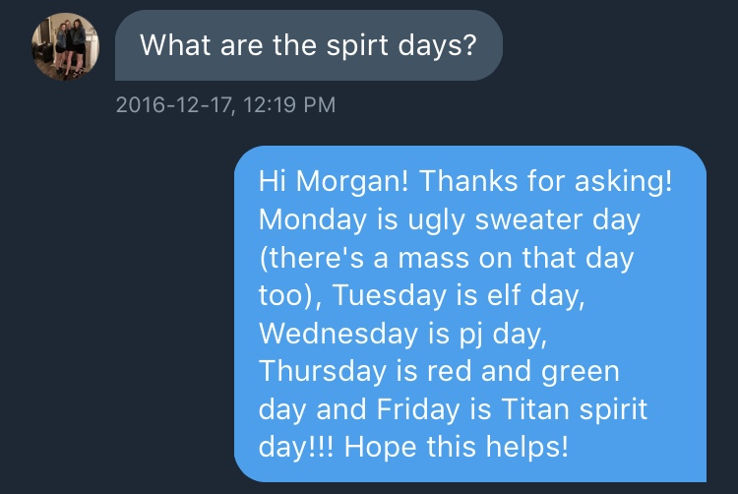
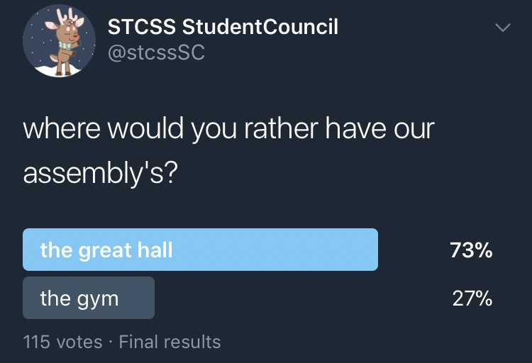
Responding to Student Voice

Slide 3
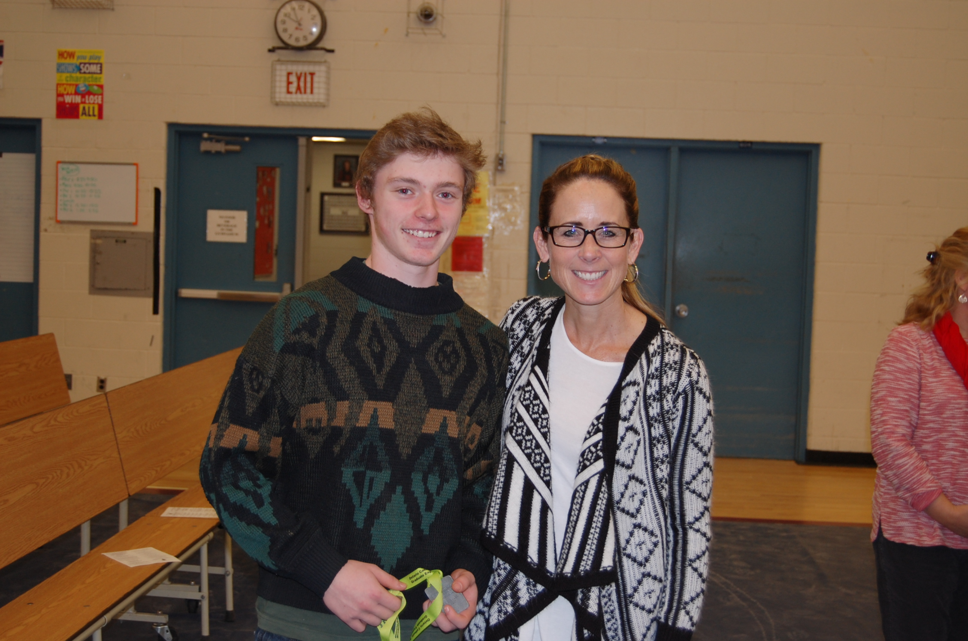
"FAITH IN ACTION"
Faith is a key component in our school community and our masses are student led.
"Good Thoughts", "Good Words", and "Good Deeds" awards rooted in the CGE's.

Slide 4
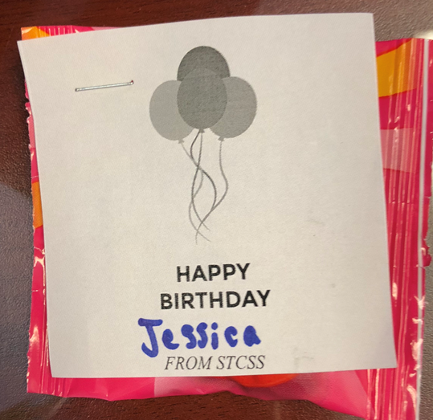
SAFE AND CARING SCHOOL COMMITTEE Initiatives
Survey Monkey
Birthday Candy

Slide 5
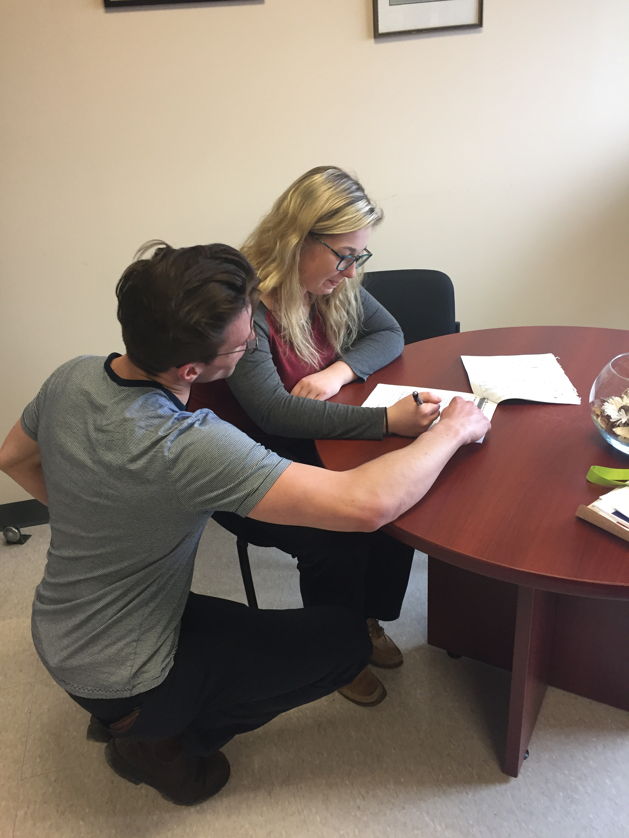
OSSLT: STAFF INITIATIVE
Caring adults become
Literacy Champions

Slide 6
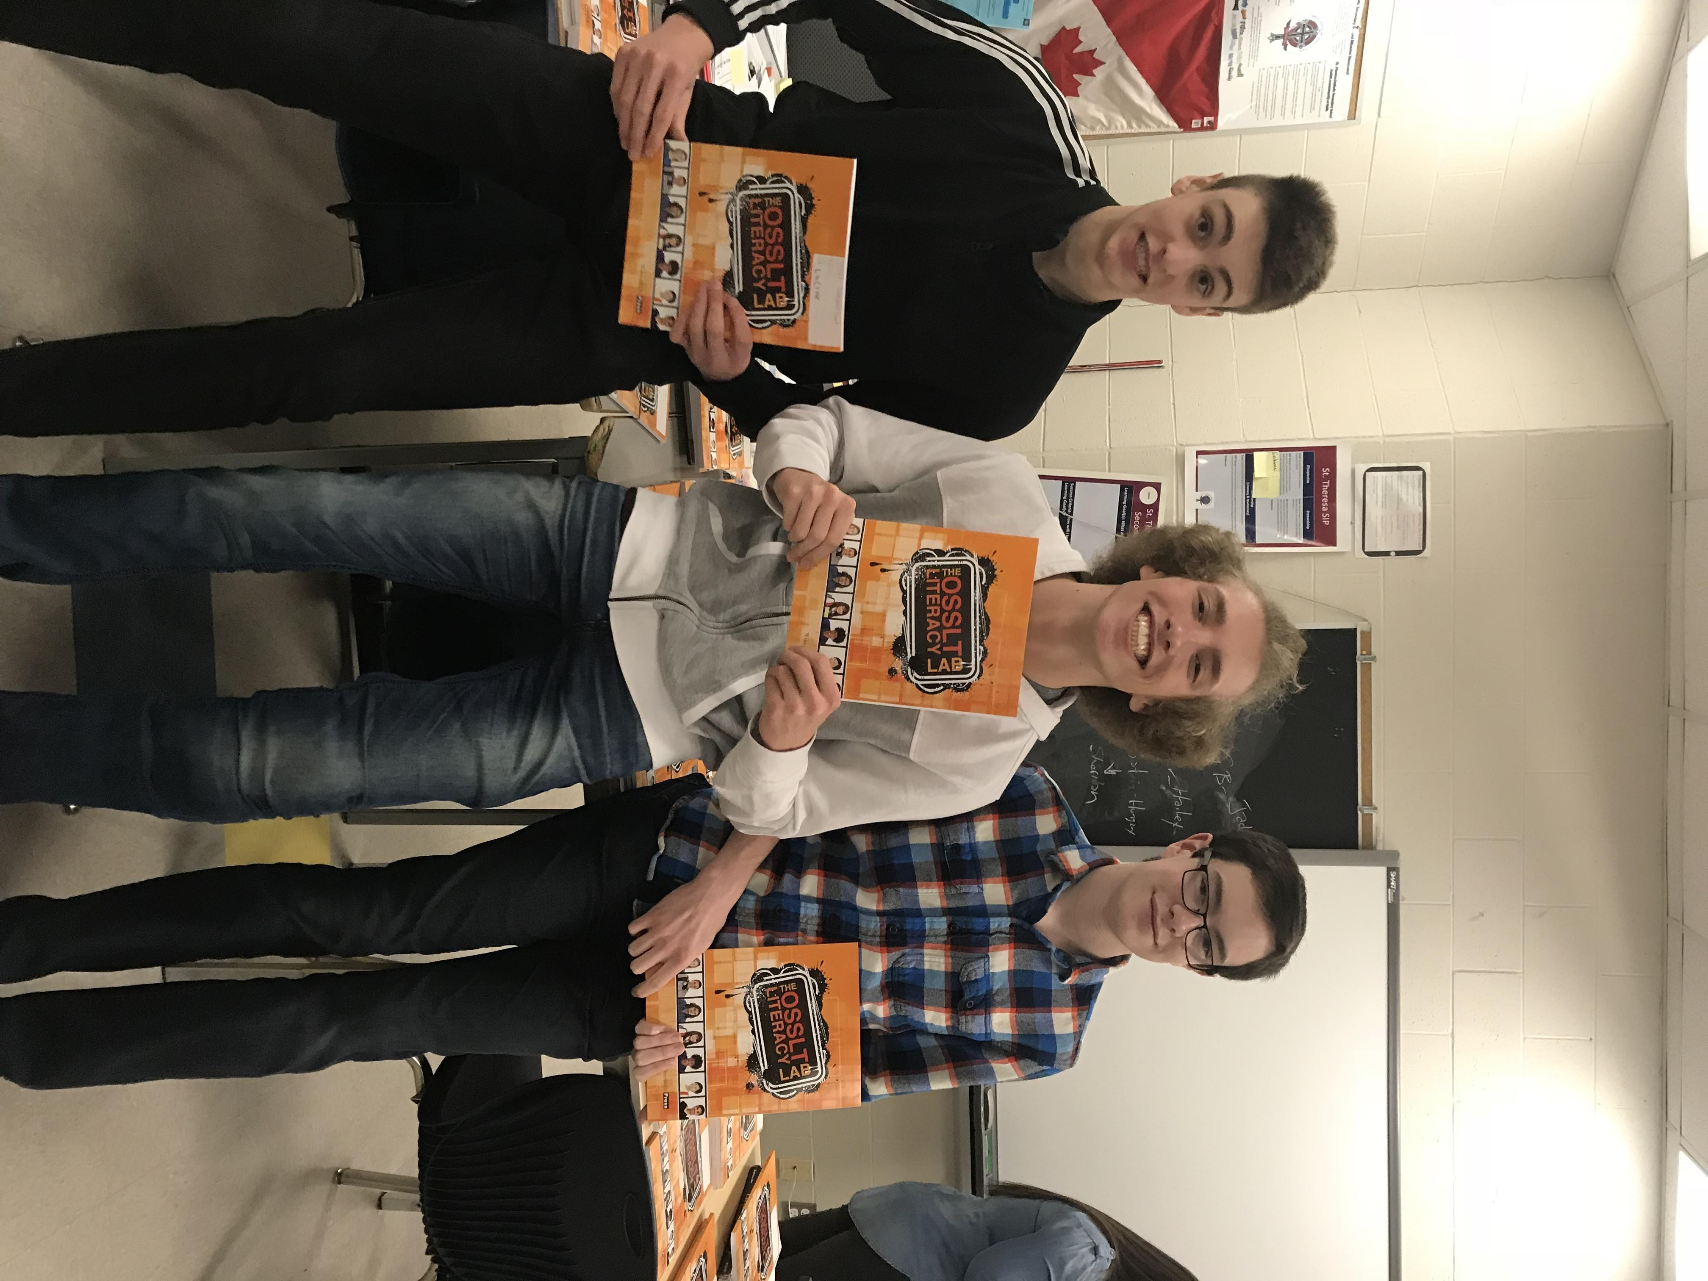
OSSLT: STUDENT INITIATIVE
Student mentors are assigned a Grade 10 class to help with their OSSLT preparation

Slide 7
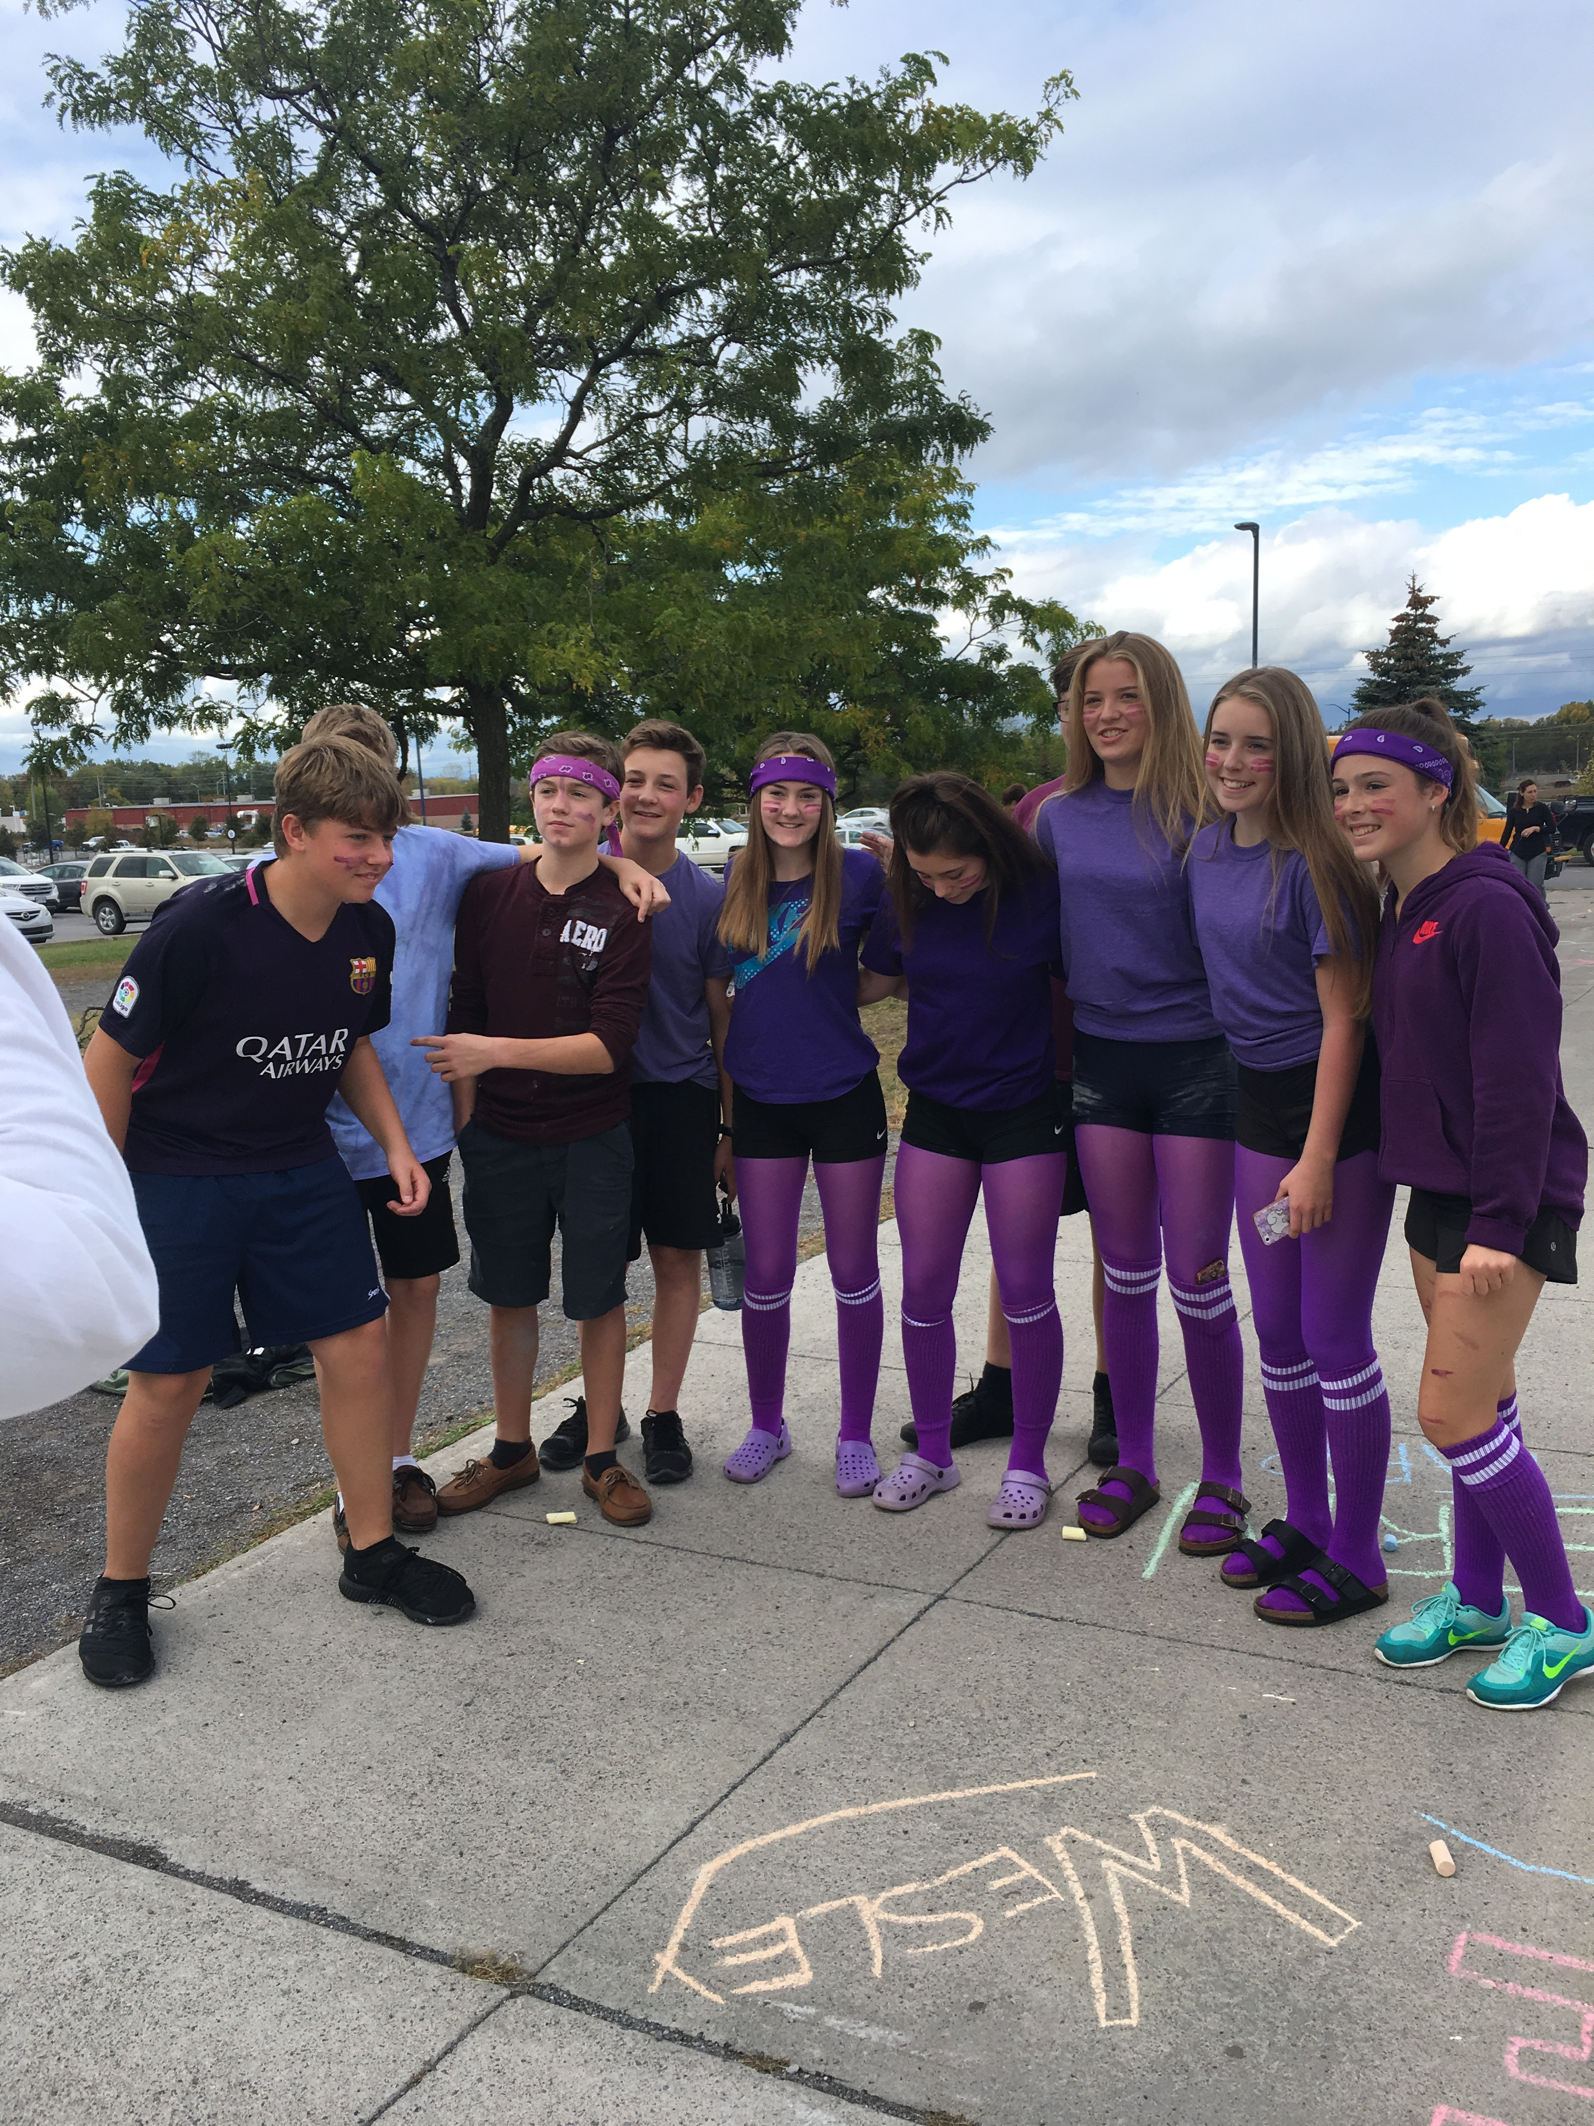
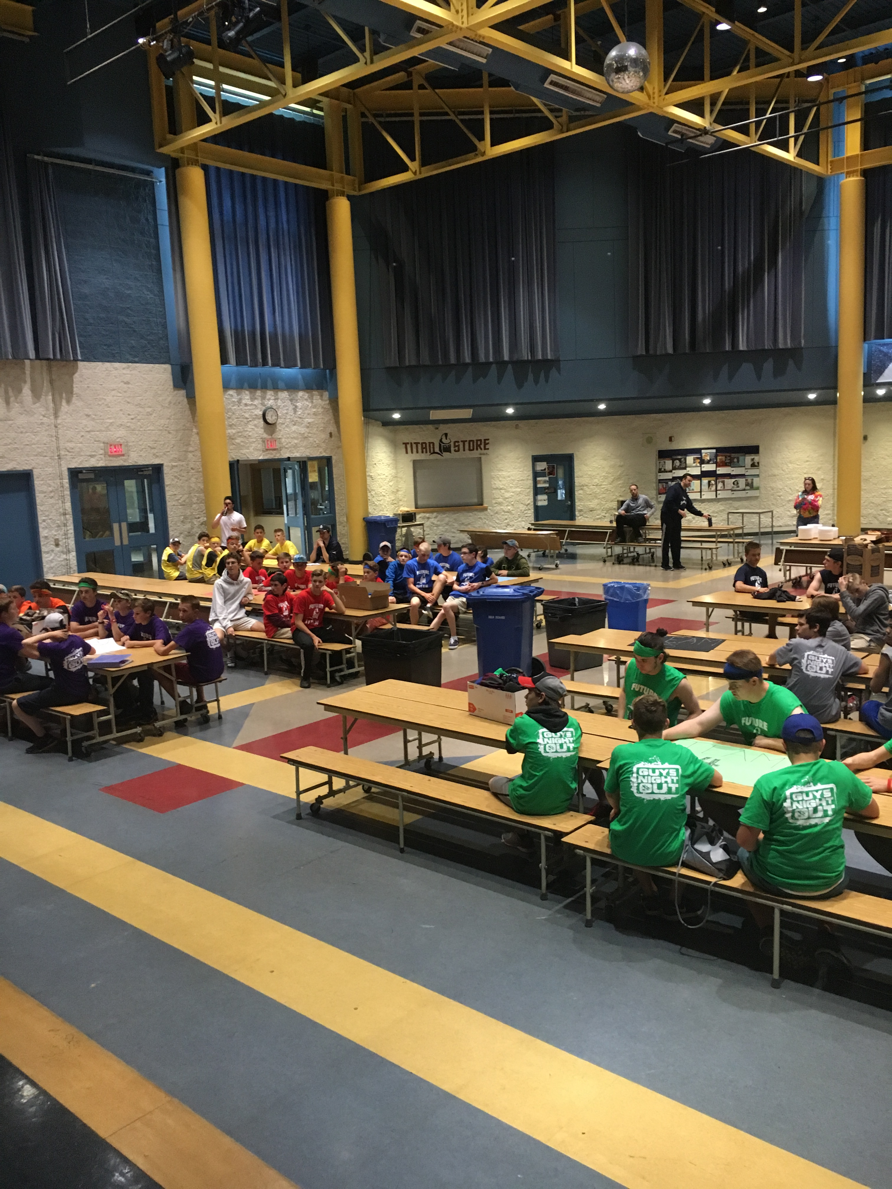
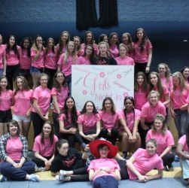
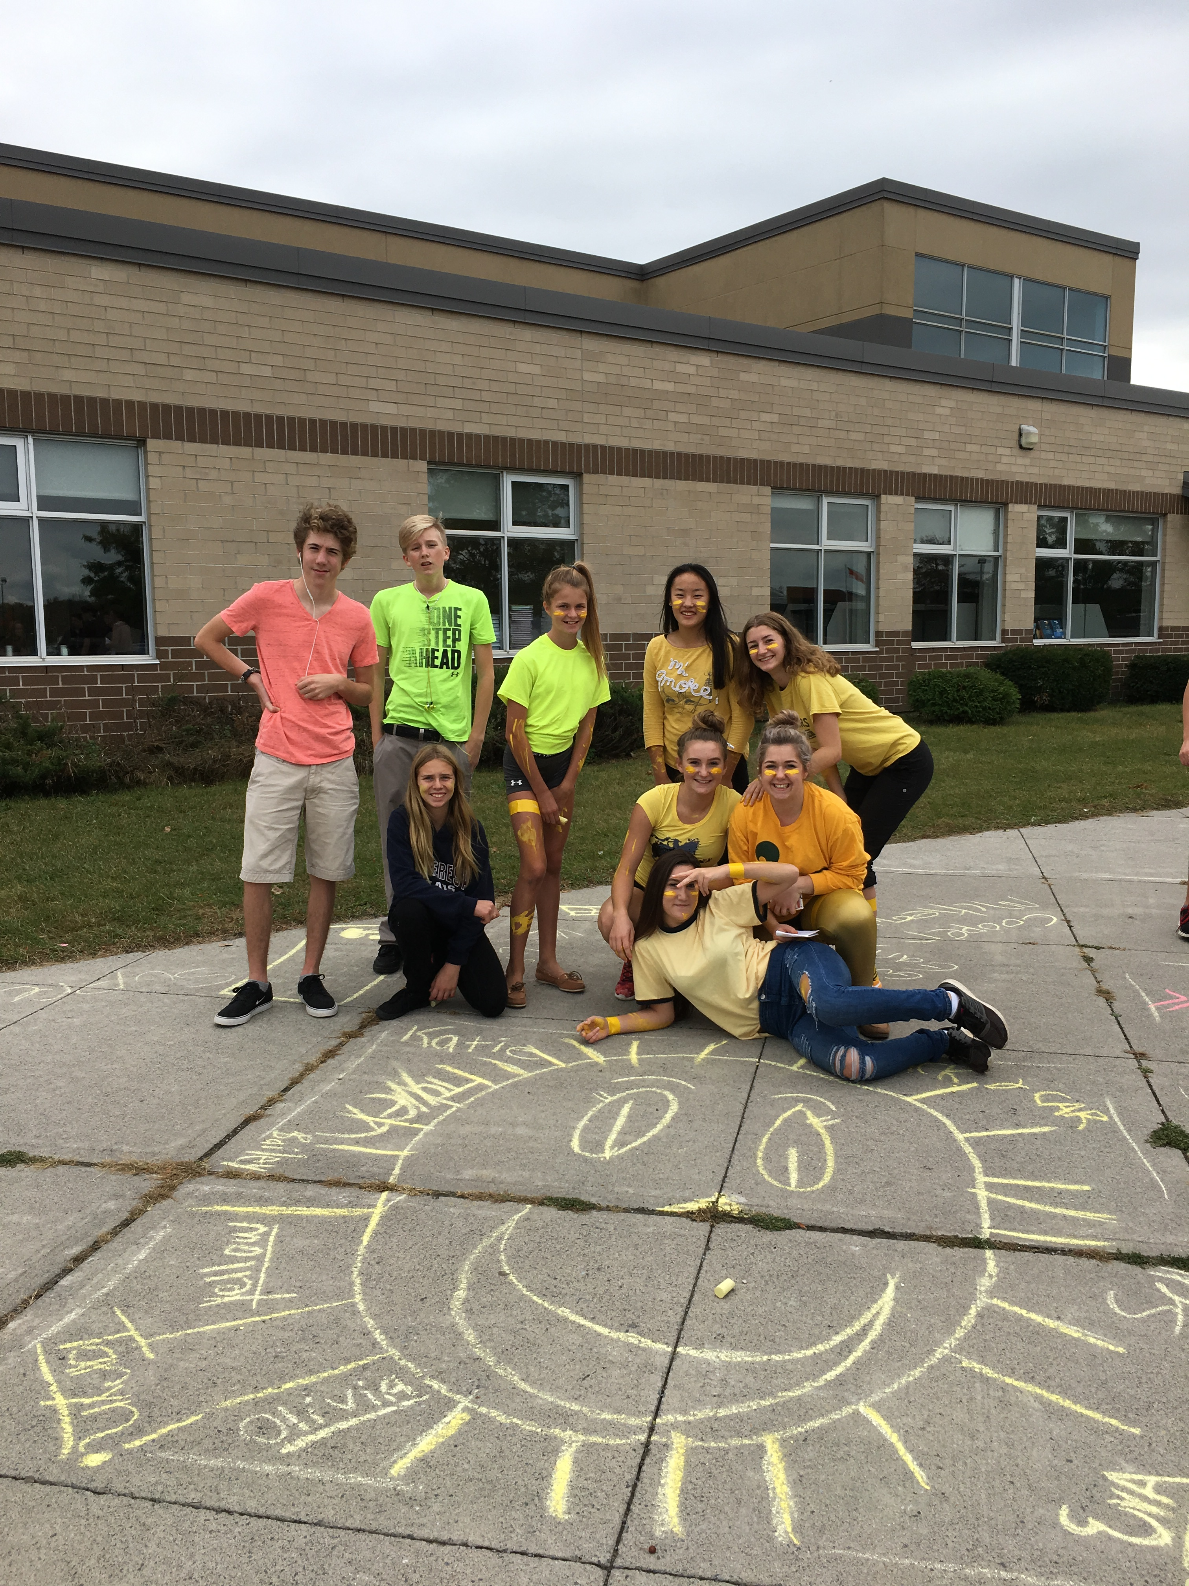
Supporting Transition to High school
St. Theresa organizes many activities to help Grade 8's going into Grade 9 transition smoothly into high school.

Slide 8
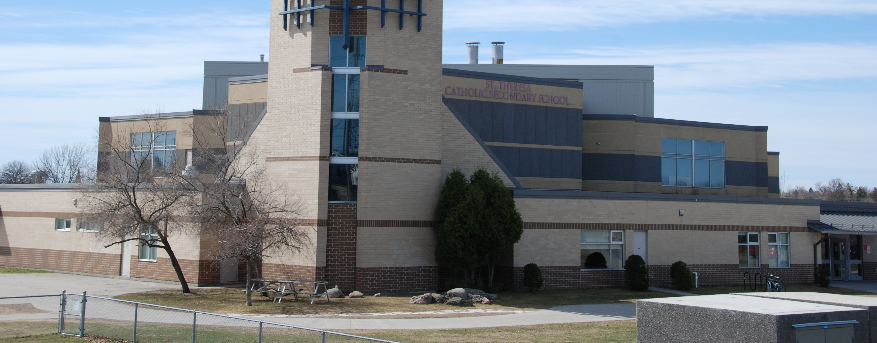
THANK YOU
"Once a titan always a titan"

