Slide 1
Welcome to School at St. Theresa
Presentation By: Taylor russett & Devon Hall & Carey Smith-Dewey
Notes:
Dewey

Slide 2
Discipleship Digging Deeper
Leadership Conference on Restorative Circles with Sacred Heart Marmora and St. Carthagh, Tweed
Literacy and Numeracy and technology enrichment activities with Georges Vanier
Voice Conference with Georges Vanier & Holy Rosary
Spring Rugby Clinic- open
Summer Football Clinic- open
Notes:
Dewey

Slide 3
School Visits
We Visit Feeder Schools to talk about academics at STCSS and show them how to Use myblueprint.ca
https://core.myblueprint.ca/V5/Dashboard/Dashboard
Notes:
Transition Planning activities
Disuss Sports like Hockey, Cheer, Dance, Volleyball
Varity of sports

Slide 4
Parent Night
All Feeder and Non-Feeder School parents & children welcome
Information night which focuses on academic streams, school supports, registration process, and upcoming transition activities (January to August)

Slide 5
Grade 8 Orientation Day
Fun Activities
School Tours
Exposure to all academic programs throughout the school

Slide 6
Shadow Day
Spring of School Year
For Registered Students for upcoming school year
Grade 9 Students hand picked to suit Grade 8’s interests/ pathways

Slide 7
Guys Night Out & Girls Night In
Long standing events that build relationships between Current students, staff and incoming Titans .

Slide 8
Scholarship Headstart Camp
Week before back to School
Literacy/ Numeracy and STEAM activities and orientation focused

Slide 9
Stewardship Used Uniform Sale
Catholic School Council in action
Gently used uniform sold to any incoming students at half price

Slide 10
Registration Day
Pay Student Fees
Lockers
Tours with Peer Mentors
Timetable walkthrough

Slide 11
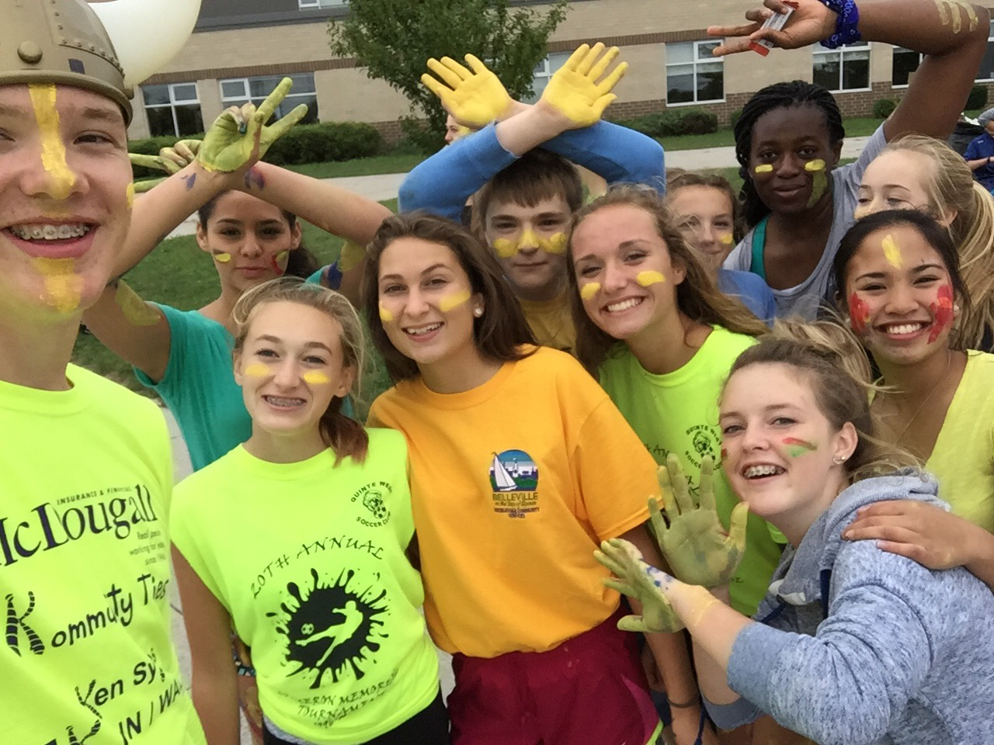
Grade 9 Day
Make New Friendships
Have Fun
Connect With Peer Mentors and Student Council
Play Classic Titan Games
Get Messy

Slide 12
Ongoing Class Visits
Assign Tutors
Talk about Issues
Resolve Conflicts
Establish Relationships

Slide 13
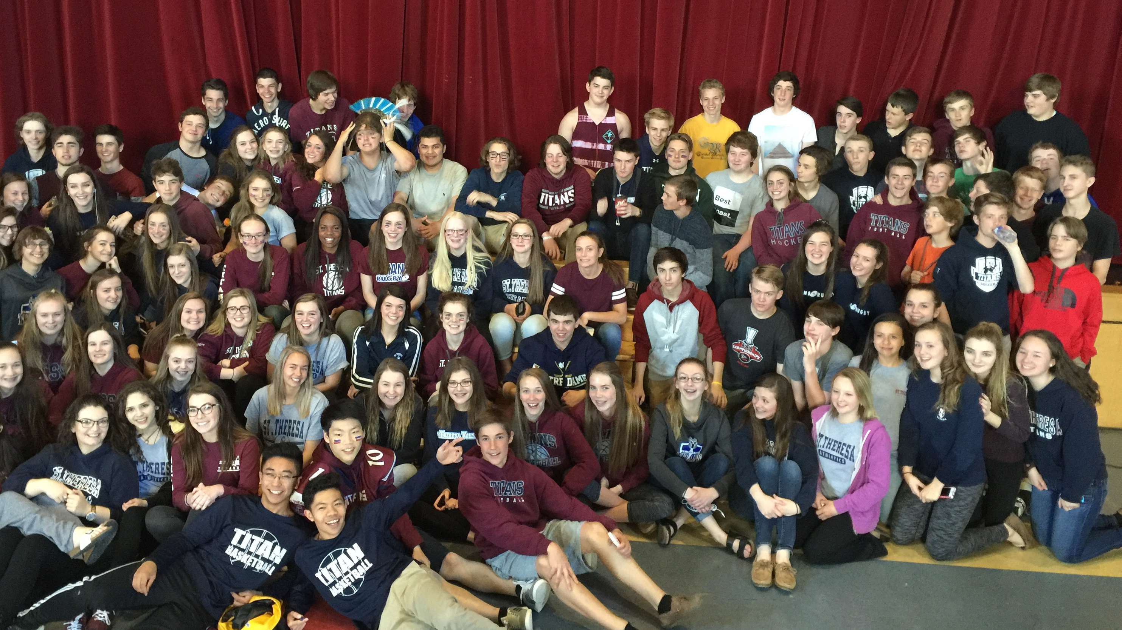
Building Community
Titan Olympics
Relay For Life
Christmas Sharing
Spirit Weeks
Hunger Games
SPIRIT WEAR
Coffee House
Assembly
Wellness Week
ETC…….

